Slide 1
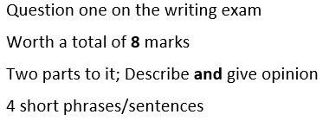

Slide 2
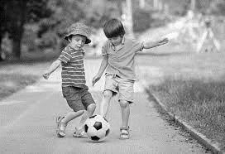

Slide 3
Fastfood
Typical activity-eg what you eat for breakfast
Typical physical activity you like doing
Cigarettes

Slide 4
P | Fastfood
P | Typical activity eg what you eat for breakfast
O | Typical physical activity you like doing
F | Cigarettes
ast
resent
pinion
uture

Slide 5
Step 1: Read the text
Step 2: Break down into small phrases
Step 3: Underline or highlight what you can do instantly
Step 4: Write the translation of each part you know in sentences. Leave a line for bits you don’t know, yet.
Step 5: Look at those gaps, can you think logically what needs to go there?

Slide 6
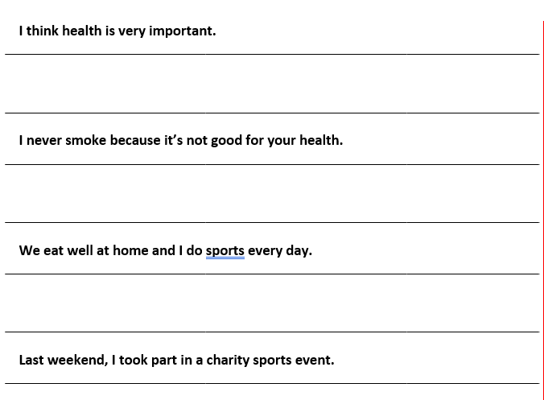

Slide 8
P.P.O.F
Right tense for the bullet point
Three tenses –
Past, present and future
J.O.E - Justify your
Opinions with an Example
Negatives
Time expressions
Adjectives and emotions
Talk about others
Use something complex to show flow
Details and description

Slide 9
P
P
O
F
ast
resent
pinion
uture

Slide 10
School:
Opinion of your school
Homework
Activities-yesterday
Future plans
P
P
O
F
ast
resent
pinion
uture

Slide 11
School:
Opinion of your school
Homework
Activities-yesterday
Future plans
P | Activities-yesterday
P | Homework
O | Opinion of your school
F | Future plans
ast
resent
pinion
uture

