Slide 2
P.P.O.F
Right tense for the bullet point
Three tenses –
Past, present and future
J.O.E - Justify your
Opinions with an Example
Negatives
Time expressions
Adjectives and emotions
Talk about others
Use something complex to show flow
Details and description

Slide 3
P
P
O
F
ast
resent
pinion
uture

Slide 4
School:
Opinion of your school
Homework
Activities-yesterday
Future plans
P
P
O
F
ast
resent
pinion
uture

Slide 5
School:
Opinion of your school
Homework
Activities-yesterday
Future plans
P | Activities-yesterday
P | Homework
O | Opinion of your school
F | Future plans
ast
resent
pinion
uture

Slide 6
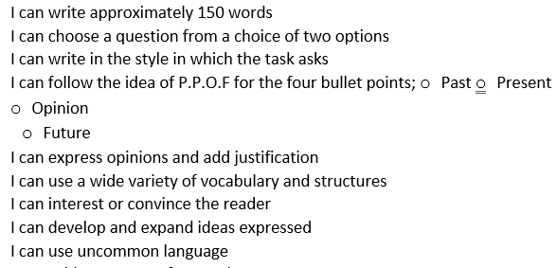

Slide 8
The advantage/disadvantage of your holiday destination
A memorable occasion/day/night/event during your holiday

Slide 9
Step 1: Read the text
Step 2: Break the text down into sentences
Step 3: Underline or highlight what you can do instantly
Step 4: Write the translation of each part you know in sentences. Leave a line for bits you don’t know, yet.

Slide 10
I love sport, I play football twice a week and I often go to the sports centre.
My older brother wants to get fit.
He never used to do any exercise, but he joined a gym last month.
He has also started running everyday and he would like to continue doing it even in winter.

