Slide 1
Paper 1- Mock Revision
For your mocks, you will have 3 papers.
Paper 1- Origins and Meaning, Good and Evil- 1 hour 30 mins
Paper 2-Sin and Forgiveness, Life and Death- 1 hour 30 mins
Paper 3- Judaism beliefs and practises- 1 hour
Use your revision packs to help you revise. Use exam papers online to revise.
In your revision packs are a Paper 1 and Paper 3. These papers are to be completed for homework and handed in during your first lesson after your Feb half term.

Slide 2
Origins and meaning revision

Slide 3
Creatio ex nihilo
Evolution
Imago Dei
Inspiration
Omnipotence
Revelation
Stewardship
Transcendence

Slide 4
Creatio ex nihilo | Creation out of nothing. Before God created the universe, nothing existed. Only God can create out of nothing.
Evolution | The process of mutation and natural selection which leads to changes in species over time to suit particular environments.
Imago Dei | in the image of God.
Inspiration | “God breathed”. The belief that the Spirit of God guides an individual to act or write what is good or true,
Omnipotence | The belief that God is all powerful.
Revelation | the ways in which God makes himself known to human beings.
Stewardship | The duty to care for creation responsibly as stewards and to protect it for future generations.
Transcendence | Existing outside of space and time

Slide 5
Genesis 1
God created the world creatio ex nihilo
God created the world in 7 days
God created man on day 6
(Imago Dei) “So God created them in his own image.” (Genesis 1:27)
God commanded things into existence/ created through word alone
Omnipotent
Transcendent

Slide 6
Interpretations of Genesis
Fundamental view of Genesis
Direct revelation
Word of God
Take scripture literally
No contradictions
Do not accept scientific theories of creation
The world was created in 7 days by God as stated in Genesis
Liberal view of Genesis (Catholic)
Writers were inspired by God/ the words/ stories may have changed over time
Not supposed to be read literally, but metaphorically
God may be responsible for the Big Bang
Scientific theories of creation are accepted e.g. one day in Genesis may be a period of time

Slide 7
Jewish beliefs about creation
In Jewish belief, God is the source of all life and referred to throughout the Torah as the sole creator.
Genesis (the first book of the Torah) tells two creation stories:
The 7 days of creation. Each week observant Jews celebrate Shabbat and keep it as a day of rest.
The second creation story in Genesis describes how Adam and Eve were created and placed in the Garden of Eden. In both, humans are created on the sixth day. Adam, the first human being, was made in the image of God, from dust from the earth. Adam and Eve had power over all things.
Traditionally Rosh Hashanah is the celebration of the day when God created the world and marks the beginning of the New Year.
Orthodox Jews = true accounts.
Reform Jews = stories which shouldn’t be considered as historical facts/ would accept scientific theories

Slide 8
Scientific theories of creation
Evolution- The process of mutation and natural selection which leads to changes in species over time to suit particular environments.
Big Bang- the rapid expansion of matter from a state of extremely high density and temperature which marks the origin of the universe
George Lemaitre
Built on by Stephen Hawking

Slide 9
Catholic views
Accept the Big Bang
Accept evolution
George Lemaitre
Liberal view!!

Slide 10
Sanctity of life / Imago Dei
Imago Dei = Latin for ‘the image of God’.
Dignity = humans are worthy of respect.
Sanctity of life = human life is a gift from God and belongs to God alone
“So God created mankind in his own image, in the image of God he created them; male and female he created them.” (Genesis 1:27)

Slide 11
St. Catherine of Siena
Humans originate from God- ‘Her dignity is that of her creation, seeming that she is made in the image of God.’
Conscience - when we look in a mirror we see our face, the good and the bad. ‘In that same mirror of the goodness of God, the soul knows her own indignity, which is the consequence of her own fault.’
Love- ‘You are taken with love for her; for by love indeed you created her.’

Slide 12
Stewardship
God created all living beings
God created the world with the right conditions to sustain life
The earth belongs to God; we are ‘care-takers’ of God’s world
Pope Francis- Laudato Si: encourages Catholics to think about the gift of creation and future generations. He gives practical ways that people can show good stewardship
Love your neighbour as yourself
The common good- every individual has a responsibility to contribute
Universal destination of goods- the current generation does not own the world, they are to look after it for future generations

Slide 13
Humanist views
Good without God- agree with the idea of stewardship/ if we do not preserve the environment we are damaging ourselves without realising it
We should care about future generations
Population control; demand for the earth’s resources means that we should use birth control programmes
Speciesism- Peter Singer/ humans are prejudice towards animals/ bees are threatened globally and a third of all the food we eat is pollinated by bees

Slide 14
Jewish views
In the first book of the Torah, God gave humans the duty to take care of the world
It is their responsibility to make the world a better place to live
Tikkun olam- healing the world. This includes not wasting or destroying the environment
Sukkot celebrates God’s creation and the keeping of Sukkot is a mitzvoth
Tu BiShvat- festival of planting trees

Slide 15
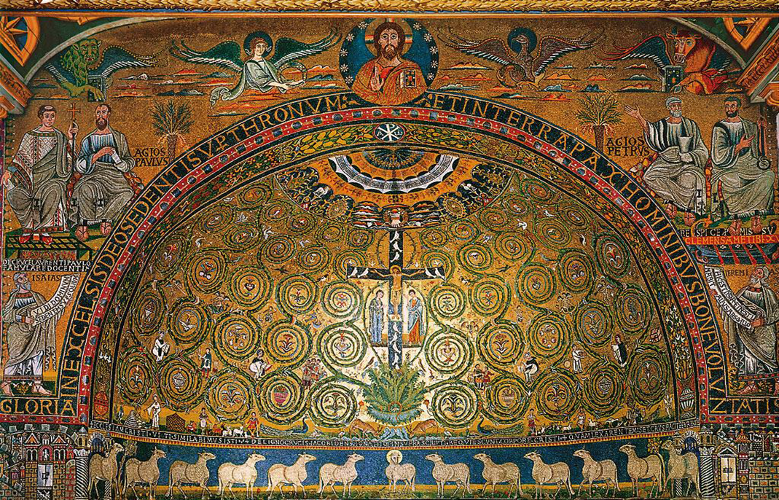
Michelangelo’s Creation of Adam
The Tree of Life Apse Mosaic
Starter task. You have 5 minutes to write down what each of these pieces of work teach us about Catholic beliefs.

Slide 16
Michelangelo’s Creation of Adam

Slide 17
Michelangelo’s Creation of Adam
Adam has a very relaxed posture. He seems less engaged in responding to the touch of God. This may be linked to Adam’s sinful nature.
Adam is depicted as a perfect human- link to everything that God created was good
Adam’s body appears to shrink away from the body of God. This might reflect Michelangelo's understanding of being created in the image and likeness of God.
God is shown as being an elderly yet muscular, grey haired man with a long beard. His beard also suggests the movement of flight forward as his beard waves behind him. This depicts God as a fatherly figure.
The cloud could represent God’s transcendence, it could be a brain showing God’s omniscience or a womb showing that God gives life
The woman could be Eve- not yet created, yet already in the mind of God

Slide 18
The Tree of Life Apse Mosaic

Slide 19
Representations of Jesus
The alpha and omega are the first and last letters of the Greek alphabet, which express completion. We are reminded that Jesus is eternal because he is God
The Risen Jesus is depicted at the top of the entire mosaic
The Chi-Ro is a frequent symbol used in Christianity (which looks like the letters X and P). They are the first 2 letters of the word Christ in Greek.
Christ is presented as a lamb. Jesus is described as the ‘Lamb of God’ because his death saved humanity from sin

Slide 20
The 12 Apostles
The 4 evangelists (Matthew, Mark, Luke and John) were instrumental in spreading the Good News
The 12 doves represent the 12 disciples and the Holy Spirit; this is a reminder of Pentecost and the ‘birthday of the Church’
The Apostles are depicted as twelve lambs. The apostles lived sacrificial lives by giving up their homes and families to follow Jesus.

Slide 21
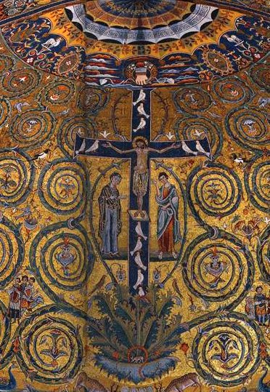
The Tree of Life
Jesus is placed on a black cross but this emphasises the brightness of his figure against it
At the top of the cross we see the hand of God reaching down to earth from heaven handing a crown to Christ. This shows how a transcendent God became immanent.
The cross emerges from a tree; this is considered the tree of life. This phrase is a reference to the book of Revelation, ‘On each side of the river stood the tree of life.. The leaves of the tree are for the healing of the nations.’
This is a reminder that all people are saved through the crucifixion and that his death ‘healed’ the world.
The cross is a complete crucifixion scene with Mary and St. John standing by the cross.
The tree and serpent at the base could be a reminder of the Garden of Eden and the tree of knowledge; this reinforces the message that sin ruins life on earth as well as the relationship between God and humans

Slide 22
Bible interpretations
Liberal
The Bible is the word of God
Writers were inspired by God
The words/ stories may have changed over time
Not supposed to be read literally, but metaphorically
The messages and morals are more important than historical truth
Fundamental
Direct revelation
Word of God
Take scripture literally
No contradictions
Should be followed word for word

Slide 23
The Torah
The first five books of the Tenakh (Torah, Nevi'im and Ketuvim)
The holiest and most authoritative scripture for Jews.
Moses is believed to have received the Torah from God on Mount Sinai.
Orthodox believe it was given by God to Moses and must be taken literally and not changed. Many will seek to obey the mitzvoth as duties in life. Society may change but Jewish teachings don’t.
For many Reform and Liberal Jews, it is not necessary to take the scriptures literally and they believe that sometimes they have to be adapted for modern life.

Slide 24
Good and Evil
Revision

Slide 25
Conscience
Evil
Free Will
Goodness
Incarnation
Natural Law
Privation
Suffering

Slide 26
Conscience | human reason making moral decisions. The knowledge we have of what is right and wrong and the God-given compulsion within all human beings to do what is right and to avoid what is evil.
Evil | the absence of good and the impulse to seek our own desires at the expense of the good of others which often results in suffering.
Free Will | the decision-making part of a person’s mind is called the will. A will is free if a person can choose right from wrong without being controlled by other forces.
Goodness | the quality of being like God: seeking the well-being of others selflessly.
Incarnation | “Made flesh” The Christian belief that God became man in the person of Jesus, fully human and fully divine.
Natural Law | the moral laws of right and wrong which are universal and not dependent on human laws. The belief in natural law is the belief that the moral law is discoverable by every human being and is the same for all human beings in all places at all times.
Privation | the loss or absence of a quality or something that is normally present. Evil is a privation of good.
Suffering | pain or loss which harms human beings. Some suffering is caused by other human beings (often called moral evil); some is not (often called natural evil).

Slide 27
St. Augustine - Enchiridion
Evil helps us to appreciate good- the existence of evil helps people to appreciate the good in the world which otherwise they would not notice
Evil is not a thing- he said that evil is the PRIVATION of good, just as darkness is the absence of light.
Evil makes us better- God allows suffering because he is omnipotent and all good. He is always able to being about a greater good.

Slide 28
Incarnation
The Word became flesh. That is Incarnation.
Incarnation refers to the central Christian belief that the Son of God assumed human nature and, as stated in the Gospel of John, “became flesh / and made his dwelling among us” (1:14).
In Christian terms the Incarnation means that God became human by the power of the Holy Spirit.
Jesus was born as a human, took on a human body, a full human nature and lived among mankind as one of them.
In doing this Jesus did not stop being God but, in some way we cannot understand, Jesus had dual nature. He was not part God and part man but wholly God and wholly man.
The kenosis hymn shows that Jesus emptied himself when he came to earth / He became flesh and became more lowly than any other person (a slave) and gave his life for us/ He suffered on earth and Christians can learn from this

Slide 29
Kenosis hymn
Kenosis = emptying
St Paul’s letter to the Philippians
It says that Christians should be like Jesus who, even though he was God, put aside his equality with God to become human
He made himself even lower by accepting a humiliating and degrading execution
It was an early hymn that Christians used to sing about Jesus
Jesus emptied himself of his equality with God

Slide 30
The Incarnation and evil
Jesus’ incarnation and suffering gives Christians a way of being able to continue to believe in the goodness of God, even in the face of human suffering.
The answer to the Problem of Evil is one that human minds might not be able to ever understand but many Christians still trust in the goodness of God.
Jewish people reject Jesus as they do not believe that He was the son of God.
Therefore they do not believe in the incarnation.
Remember- One God (10 Commandments/Shema prayer)

Slide 31
Christian responses to suffering/ ambivalence
The meaning of suffering: sometimes it brings about good
Suffering as a sign of love: love is impossible without suffering. Jesus said: ‘Greater love has no one than this; to lay down one’s life for one’s friend.’
Suffering as a proof of commitment- no pain, no gain
Suffering as a blessing- in the beatitudes, some of those who Jesus classes as ‘blessed’ are those who suffer
The suffering and death of Jesus: this shows how through Jesus’ suffering, we are saved from sin

Slide 32
Jewish views on Suffering
For Jews suffering comes from 2 sources- human and nature
Suffering is a result of the human inclination to choose evil
Some suffering can come from God as a test or punishment
They should not question why God has sent suffering

Slide 33
Isaiah 53- overview
Catholic view
A prophecy of Jesus
Jesus is the suffering servant in the passage
The acceptance of suffering by the servant brought about salvation
Jewish view
A metaphorical description of the suffering of Israel
The messianic age is yet to come
For Jews, suffering comes from 2 sources, humans and nature
Humans should not question why God has sent suffering

Slide 34
Plan your answer for these questions
Describe two different Christian beliefs about the origin of evil. (5 marks)
Explain the significance of Jesus' crucifixion in relation to the problem of evil. (8 marks)
‘Suffering proves that God does not exist.’ Evaluate this statement considering Christian responses. (15 marks)

Slide 35
Statues and sculptures
Catholics do not worship statues (that would be idolatry)
They are used as an aid to prayer and can help some worshippers to focus
Catholics may pray to Mary and ask for intercession
Jews do not use statues as a focus for prayer as it goes against the commandment ‘You shall have no other God’s before me.’

Slide 36
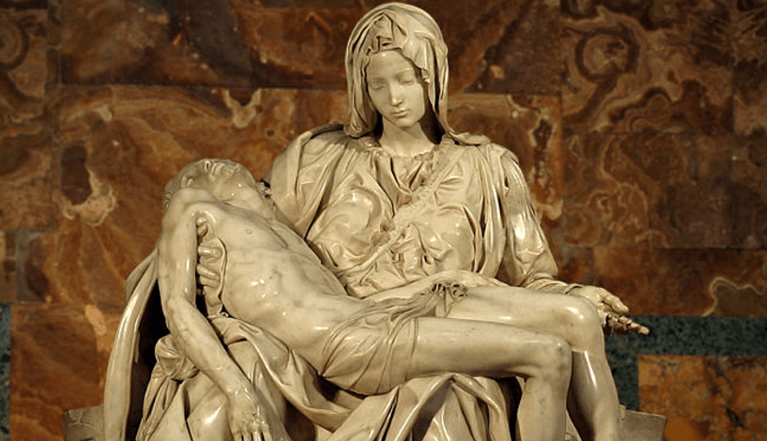
The Pieta
Jesus has been depicted as though he is sleeping peacefully – his lifeless body doesn’t reflect the horrific torture and suffering that he has gone through.
Mary’s hands do not touch Jesus’ body at all – she has her hands on the cloth that he is wrapped in. This recognises the belief that the body is sacred.
Mary appears graceful and accepting of the events through her facial expression.
Both figures are shown to be perfect even through their horrific suffering. This was because during the Renaissance period, people believed that human beauty was the reflection of God’s beauty and so they possess ‘divine beauty’

