Slide 1
The Bathurst Way
How to revise
FACE IT

Slide 2
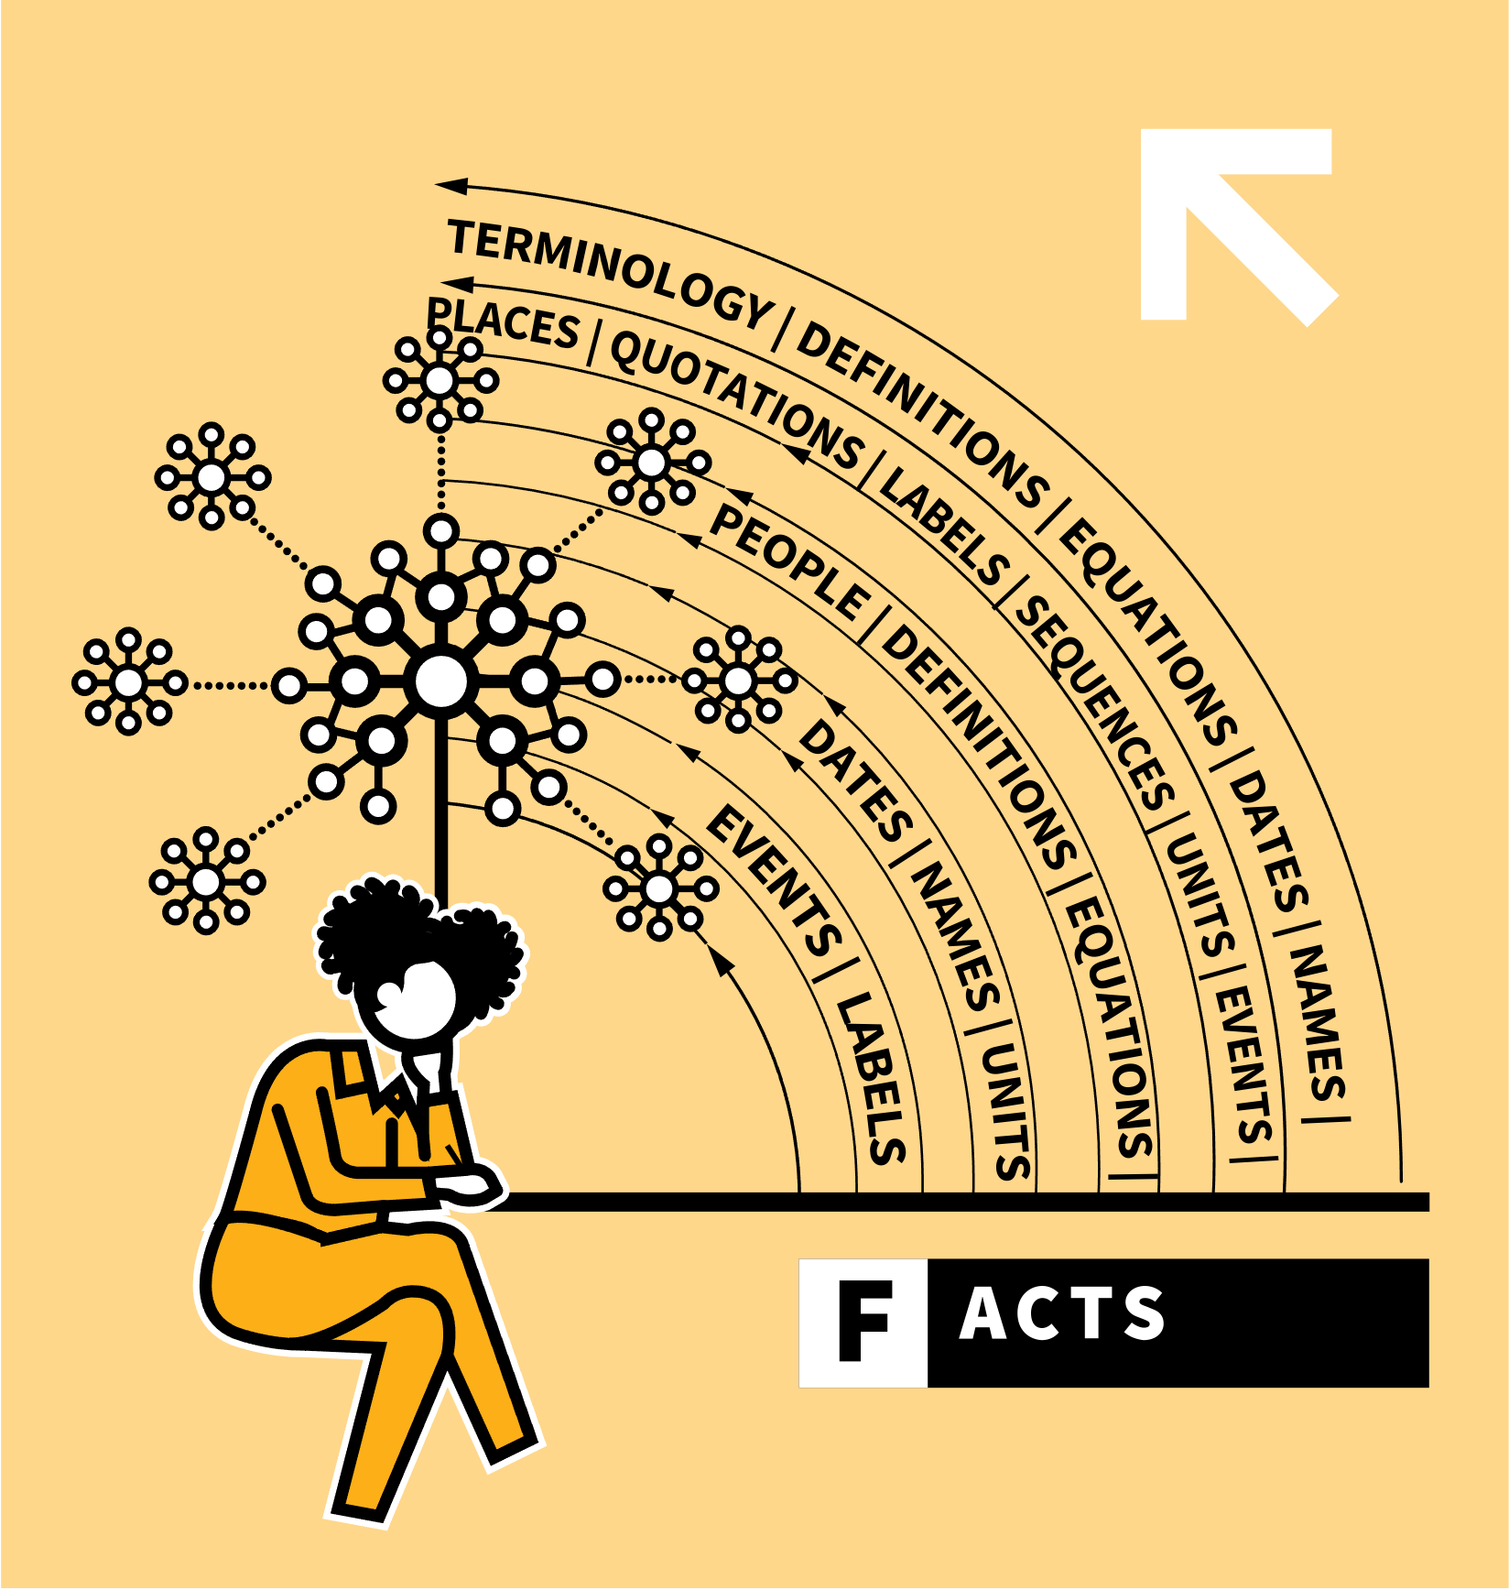
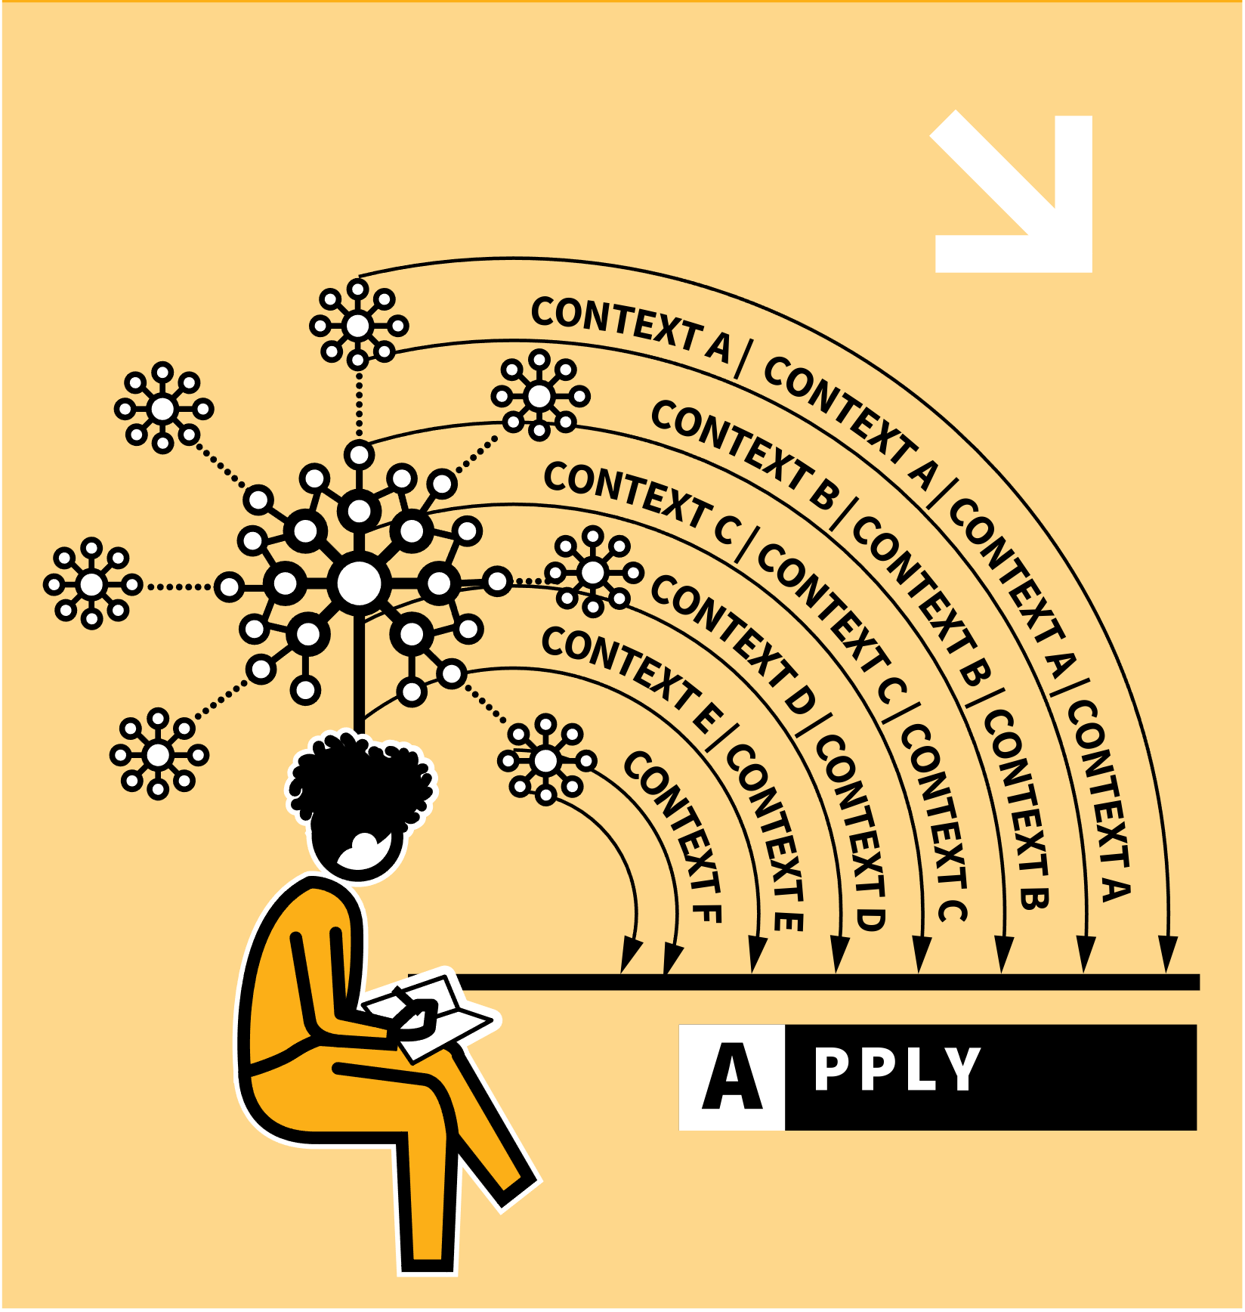
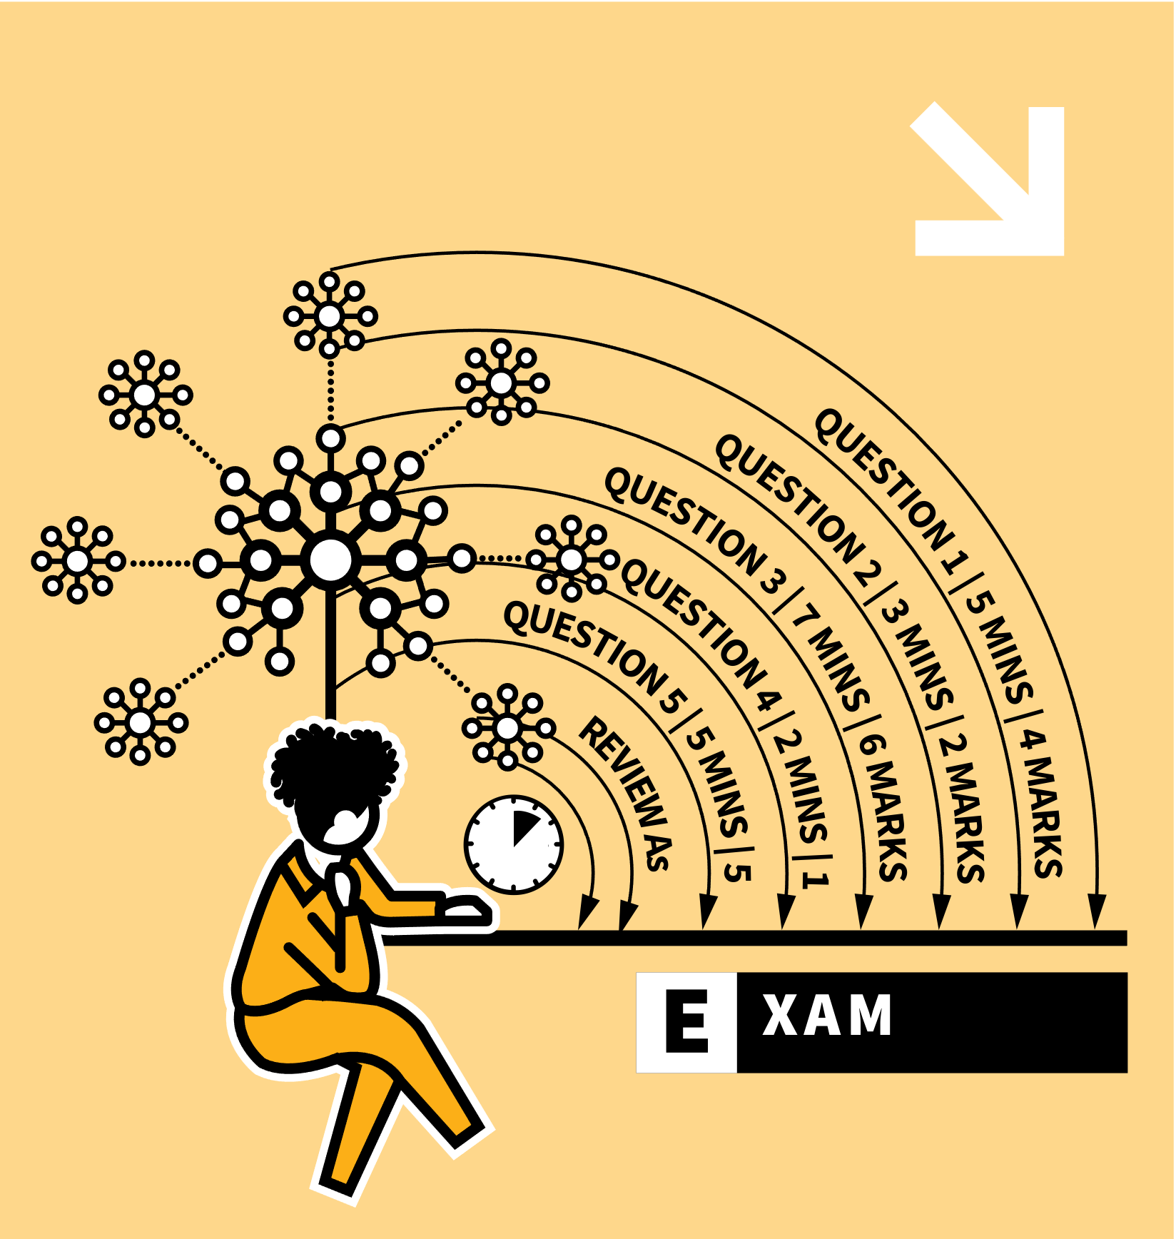
LEARNING WALKTHRUs
STUDY HABITS & TECHNIQUES SERIES
FACE IT
1
2
3
4
5
F | LEARN YOUR FACTS FIRST
A | APPLY YOUR KNOWLEDGE TO NEW PROBLEMS
C | CONNECT YOUR KNOWLEDGE WITH MORE COMPLEX QUESTIONS
E | PRACTISE IN EXAM CONDITIONS
REVISION TROUBLE? FACE IT
If you’re faced with a large amount of material to revise, ahead of examinations and assessments, there’s a process you might find helpful: FACE It.
Each letter represents some actions to take in order of difficulty.
The overall message is not to avoid the study process — make a start and then build up to the more challenging parts.

Slide 3
LEARNING WALKTHRUs
1 | 2 | 3 | 4 | 5
STUDY HABITS & TECHNIQUES SERIES
FACE IT
F | LEARN YOUR FACTS
FIRST
To begin, learn the core factual content in a topic:
terminology, definitions, equations, dates, names, places, quotations, labels, sequences, units, events, people.
This is the quizzable knowledge that you might have on flash cards or knowledge organisers.
Use a range of retrieval practice techniques like self-quizzing.

Slide 4
LEARNING WALKTHRUs
1 | 2 | 3 | 4 | 5
STUDY HABITS & TECHNIQUES SERIES
A | APPLY YOUR
KNOWLEDGE TO NEW PROBLEMS
FACE IT
With your facts secure, tackle questions where the knowledge is tested in a context, beyond straightforward recall.
It’s not enough to know isolated facts; that knowledge needs to be used in a range of contexts.
Often previous examination questions and textbooks will be a good source of questions of this type.

Slide 5
LEARNING WALKTHRUs
1 | 2 | 3 | 4 | 5
STUDY HABITS & TECHNIQUES SERIES
C | CONNECT YOUR
KNOWLEDGE WITH MORE
COMPLEX QUESTIONS
FACE IT
Attempt questions that require you to draw on knowledge from more than one topic area or to apply knowledge to previously unseen ideas.
You might need to identify patterns and causal links that haven’t been explicitly taught before.
Sometimes you may need to connect detailed ideas into a wider schema of interconnected topics.
These will be the harder questions normally near the end of an exam paper.

Slide 6
LEARNING WALKTHRUs
1 | 2 | 3 | 4 | 5
STUDY HABITS & TECHNIQUES SERIES
FACE IT
E | PRACTISE IN EXAM CONDITIONS
Use past test questions to rehearse responding under time pressure, taking account of the marks available.
Only do this once the FAC aspects are more secure. There’s no point trying to remember factual knowledge under a time limit if you haven’t previously secured that knowledge in a more low-stakes situation.
When you feel you know the material well then see how well it goes in timed conditions.

Slide 7
LEARNING WALKTHRUs
1 | 2 | 3 | 4 | 5
STUDY HABITS & TECHNIQUES SERIES
REVISION TROUBLE?
FACE IT
FACE IT
Use FACE It to support your revision planning and as a diagnostic tool:
Have you learned your Facts?
Have you practised Applying your knowledge in context questions?
Have you started to Connect ideas with more synoptic questions?
Have you tested yourself in timed Exam conditions?
This also works away from formal exam settings where E means Express your knowledge.

Slide 8
LEARNING WALKTHRUs
STUDY HABITS & TECHNIQUES SERIES
FACE IT
1
2
3
4
5
F | LEARN YOUR FACTS FIRST
A | APPLY YOUR KNOWLEDGE TO NEW PROBLEMS
C | CONNECT YOUR KNOWLEDGE WITH MORE COMPLEX QUESTIONS
E | PRACTISE IN EXAM CONDITIONS
REVISION TROUBLE? FACE IT
If you’re faced with a large amount of material to revise, ahead of examinations and assessments, there’s a process you might find helpful: FACE It.
Each letter represents some actions to take in order of difficulty.
The overall message is not to avoid the study process — make a start and then build up to the more challenging parts.

