Slide 1
The Bathurst Way
How to revise
Summarising

Slide 2
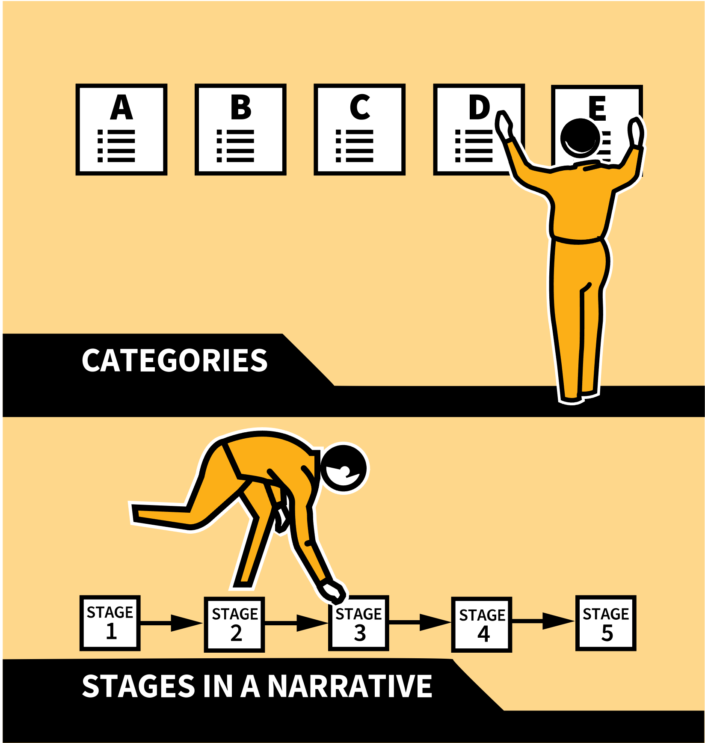
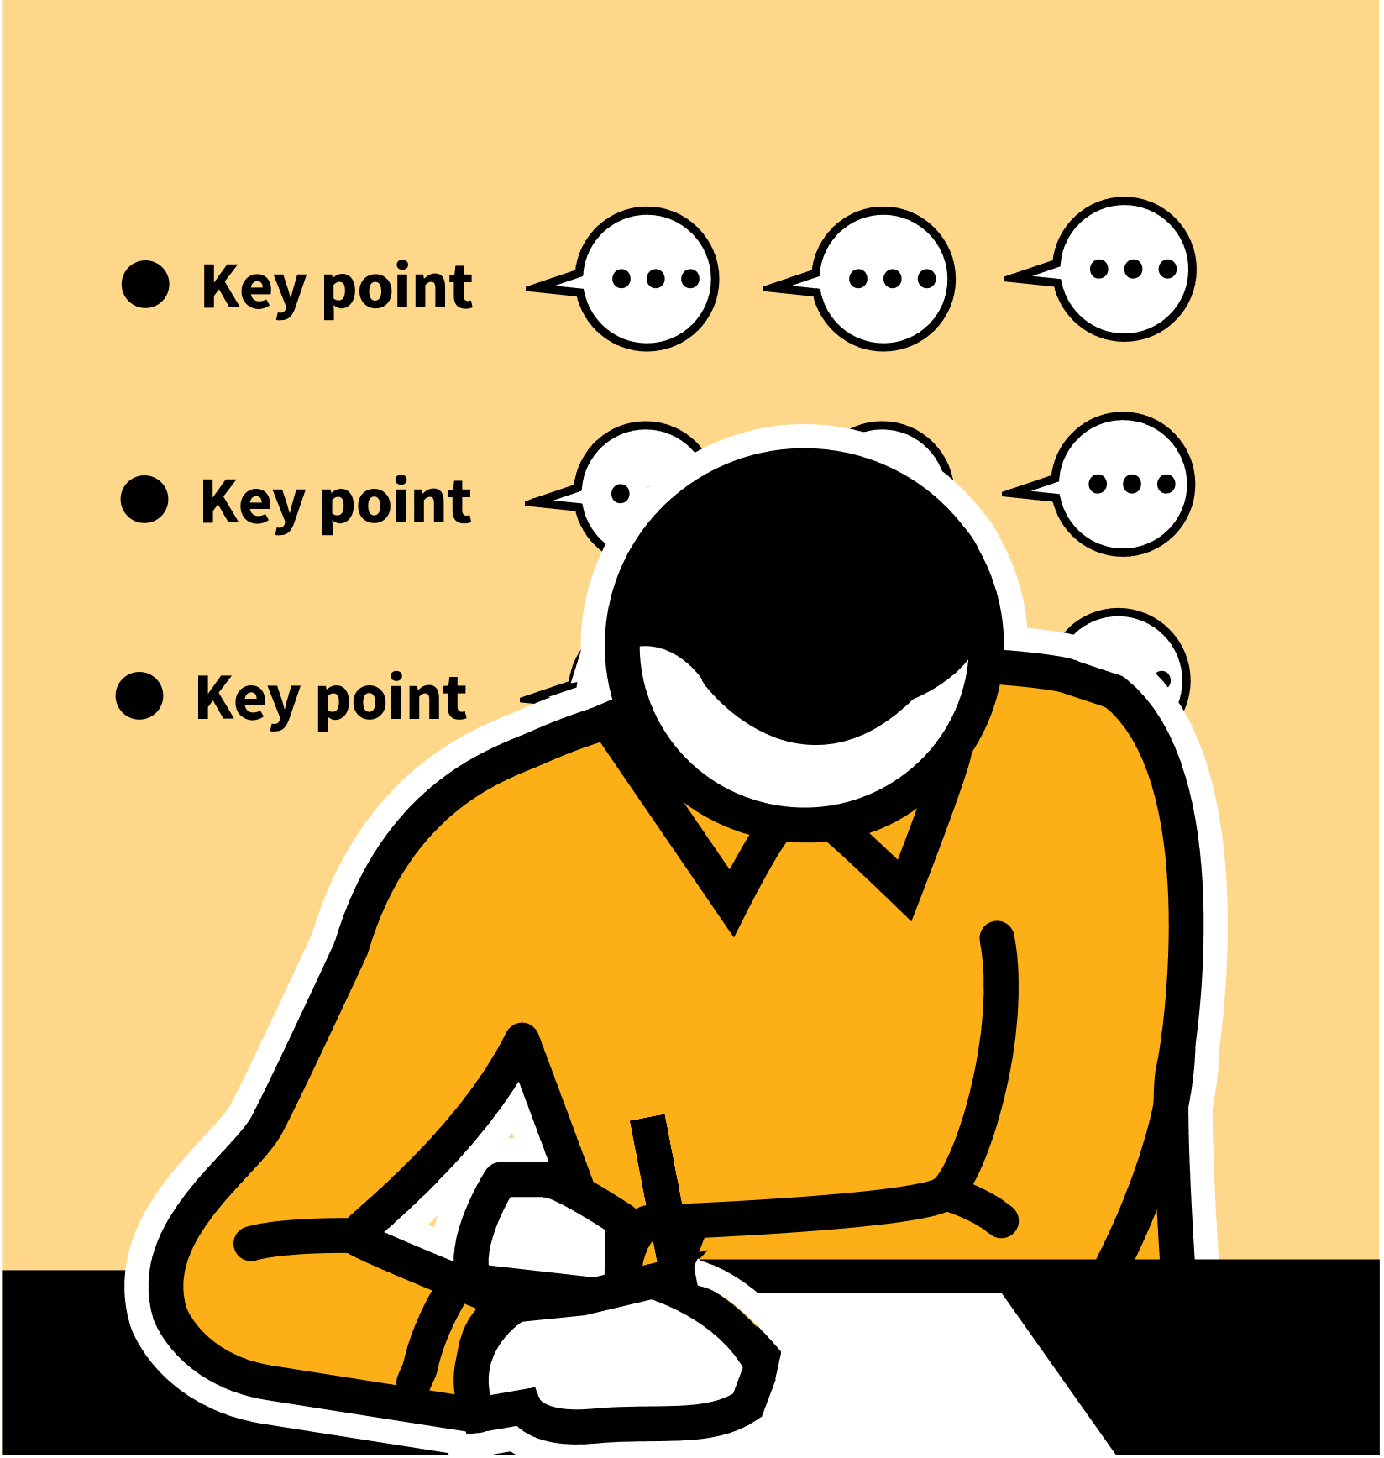
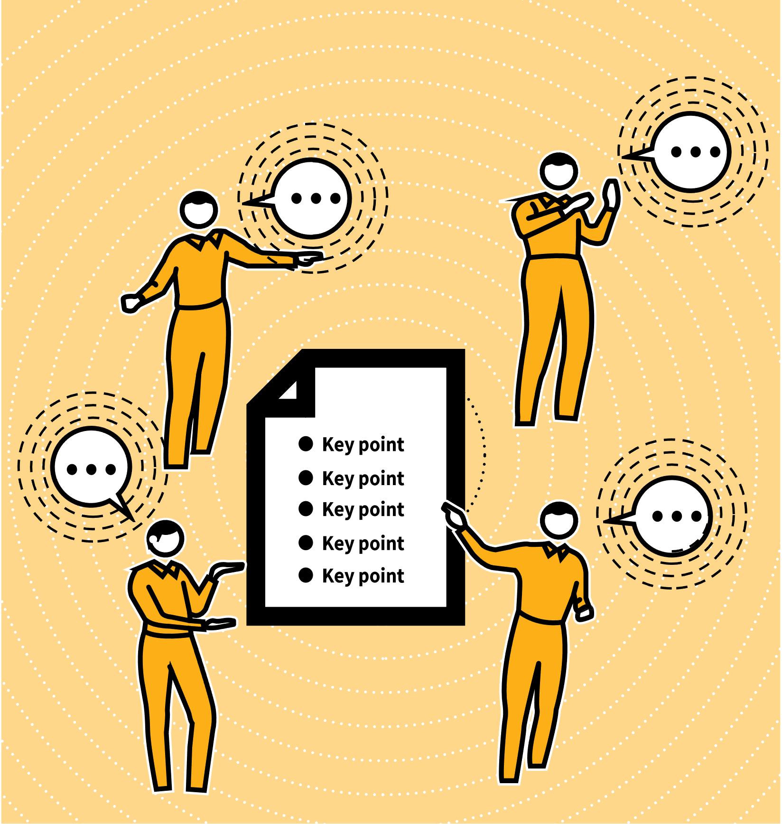
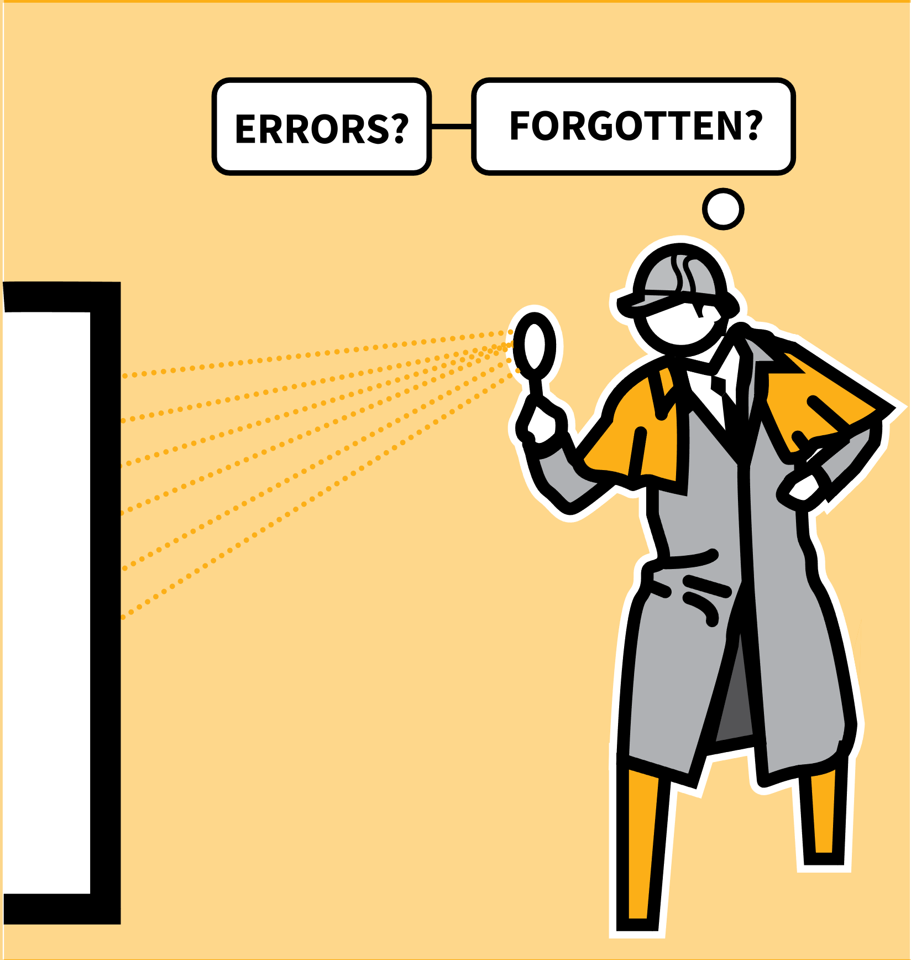
LEARNING WALKTHRUs
STUDY HABITS & TECHNIQUES SERIES
SUMMARISING | BIG IDEAS & KEY DETAILS
1
2
3
4
5
SCAN THE WHOLE TOPIC OR TEXT
BREAK DOWN INTO SECTIONS
SELECT DETAILS TO CAPTURE EACH SECTION
ELABORATE OUTWARDS FROM YOUR SUMMARY
CHECK FOR ACCURACY
Every topic you study or book you read contains more detail than you can recall all at once. We don’t ever really need to do this as our brains connect ideas into schema allowing us to create a summary map of the knowledge that guides us to the details when we need them.
If you condense a large body of knowledge to some big ideas or key stages in a process or narrative, you can add details back in, making the process of studying a large topic possible.
Summarising also helps you to understand the material more thoroughly.

Slide 3
LEARNING WALKTHRUs
1 | 2 | 3 | 4 | 5
STUDY HABITS & TECHNIQUES SERIES
SCAN THE WHOLE TOPIC
OR TEXT
SUMMARISING | BIG IDEAS & KEY DETAILS
To start:
Gain an overview of a topic
Read a whole novel or watch a play or film.
Listen to video explanations of key concepts
As you read, listen, watch or study, have the idea of summarising in mind from the start.
As you engage with the detailed, extended material, start planning your summary, making notes in bullet point form as you go.

Slide 4
LEARNING WALKTHRUs
1 | 2 | 3 | 4 | 5
STUDY HABITS & TECHNIQUES SERIES
BREAK DOWN INTO
SECTIONS
SUMMARISING | BIG IDEAS & KEY DETAILS
Break down material into a helpful number of sections. Too many make it hard to remember and keep simple; too few and you’ll compromise too much on details. For example:
CATEGORIES | e.g. human organ systems, pros and cons of different flood defences.
BIG IDEAS OR THEMES | e.g. key people, key events, main causes and outcomes of a conflict.
STAGES IN A NARRATIVE | e.g. each act in a five-act play, or stages in the carbon cycle.

Slide 5
LEARNING WALKTHRUs
1 | 2 | 3 | 4 | 5
STUDY HABITS & TECHNIQUES SERIES
SELECT DETAILS TO
CAPTURE EACH SECTION
SUMMARISING | BIG IDEAS & KEY DETAILS
The aim of a summary is to help organise a lot of information - not to replace the more detailed big picture, losing all the information.
With that in mind, select and organise the main details you need to explain or retell each of your chosen sections.
Bullet point lists are helpful for recording key points.
Keep focused on the most important things you need to know.

Slide 6
LEARNING WALKTHRUs
1 | 2 | 3 | 4 | 5
STUDY HABITS & TECHNIQUES SERIES
ELABORATE OUTWARDS
FROM YOUR SUMMARY
SUMMARISING | BIG IDEAS & KEY DETAILS
The test of a good summary is that you can use it to revisit a topic or retell a story in some detail with only the summary as a prompt.
Test this out with each summary you make.
If your summary is a short bullet point list, you should be able to expand and elaborate each point with examples and details.
Do this mentally, by yourself, or with a partner who can then verify how well your summary allows you to give a good account.

Slide 7
LEARNING WALKTHRUs
1 | 2 | 3 | 4 | 5
STUDY HABITS & TECHNIQUES SERIES
SUMMARISING | BIG IDEAS & KEY DETAILS
CHECK FOR ACCURACY
After elaborating from your summary, go back to the original text to make sure you didn’t make errors or leave out anything very important.
If you find you’ve forgotten lots of detail, you might have summarised too much into too few bullet points. Make a more detailed list.
Rehearse how the details fit the sections. Test your summary again. Can you tell the whole story from the summary you made?

