Slide 1
The Bathurst Way
How to revise
Flash cards

Slide 2
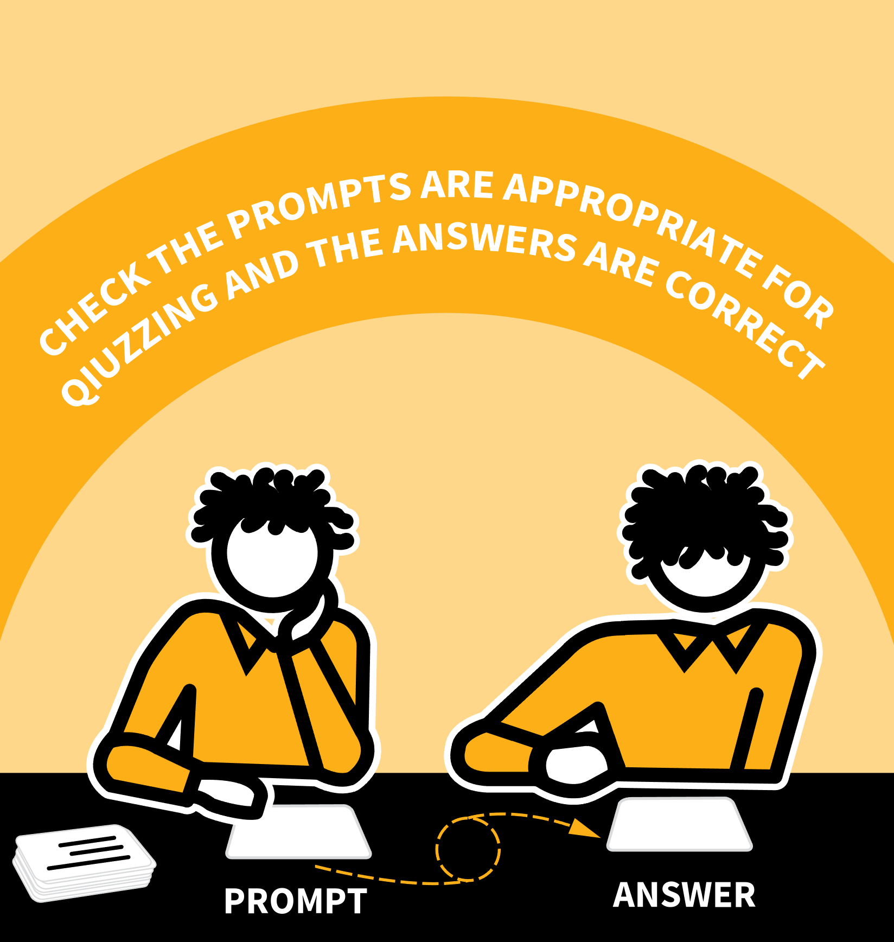
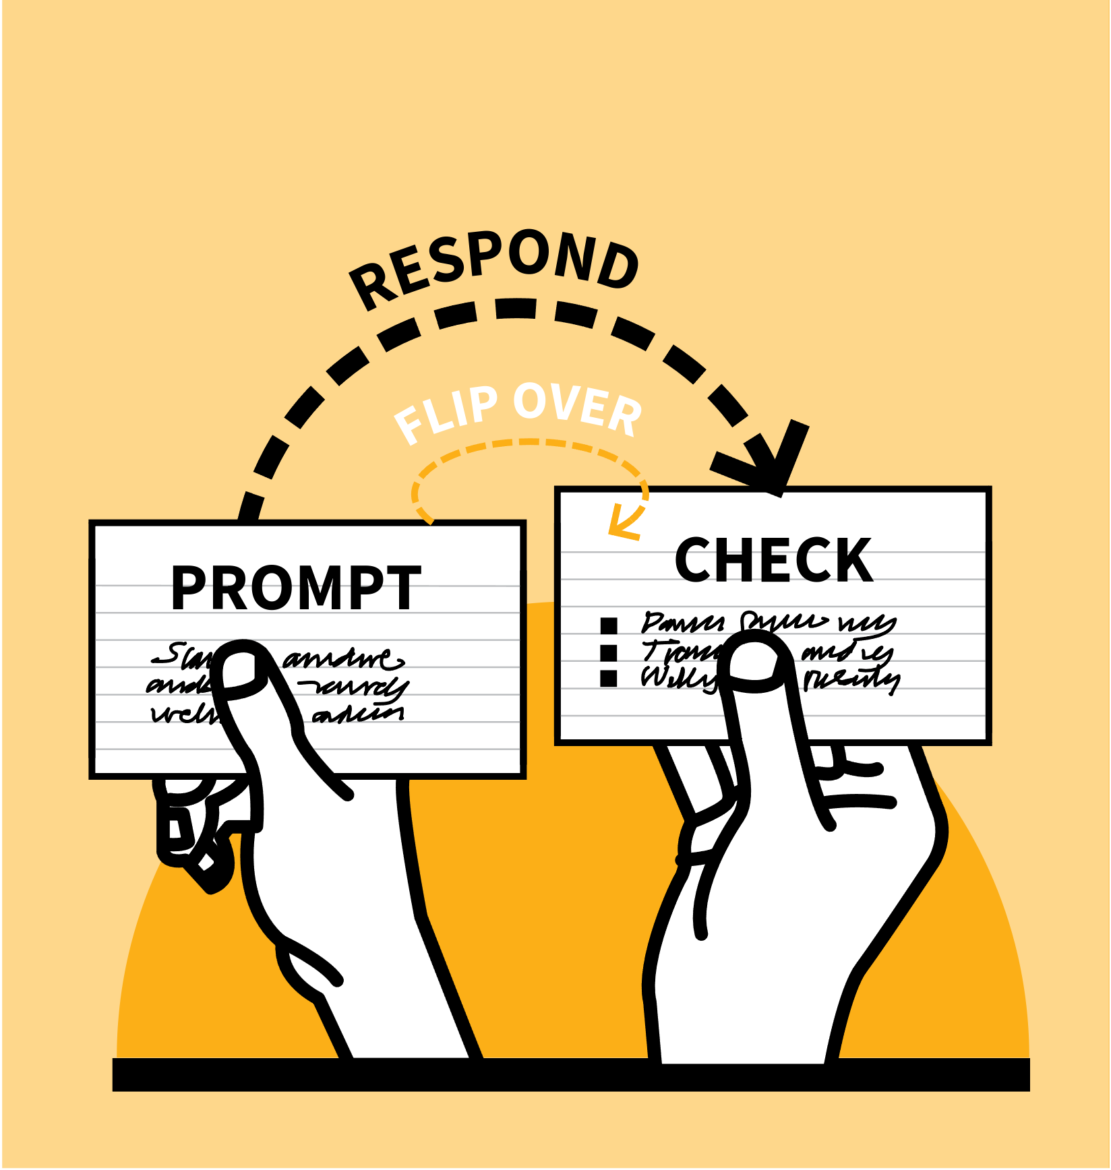
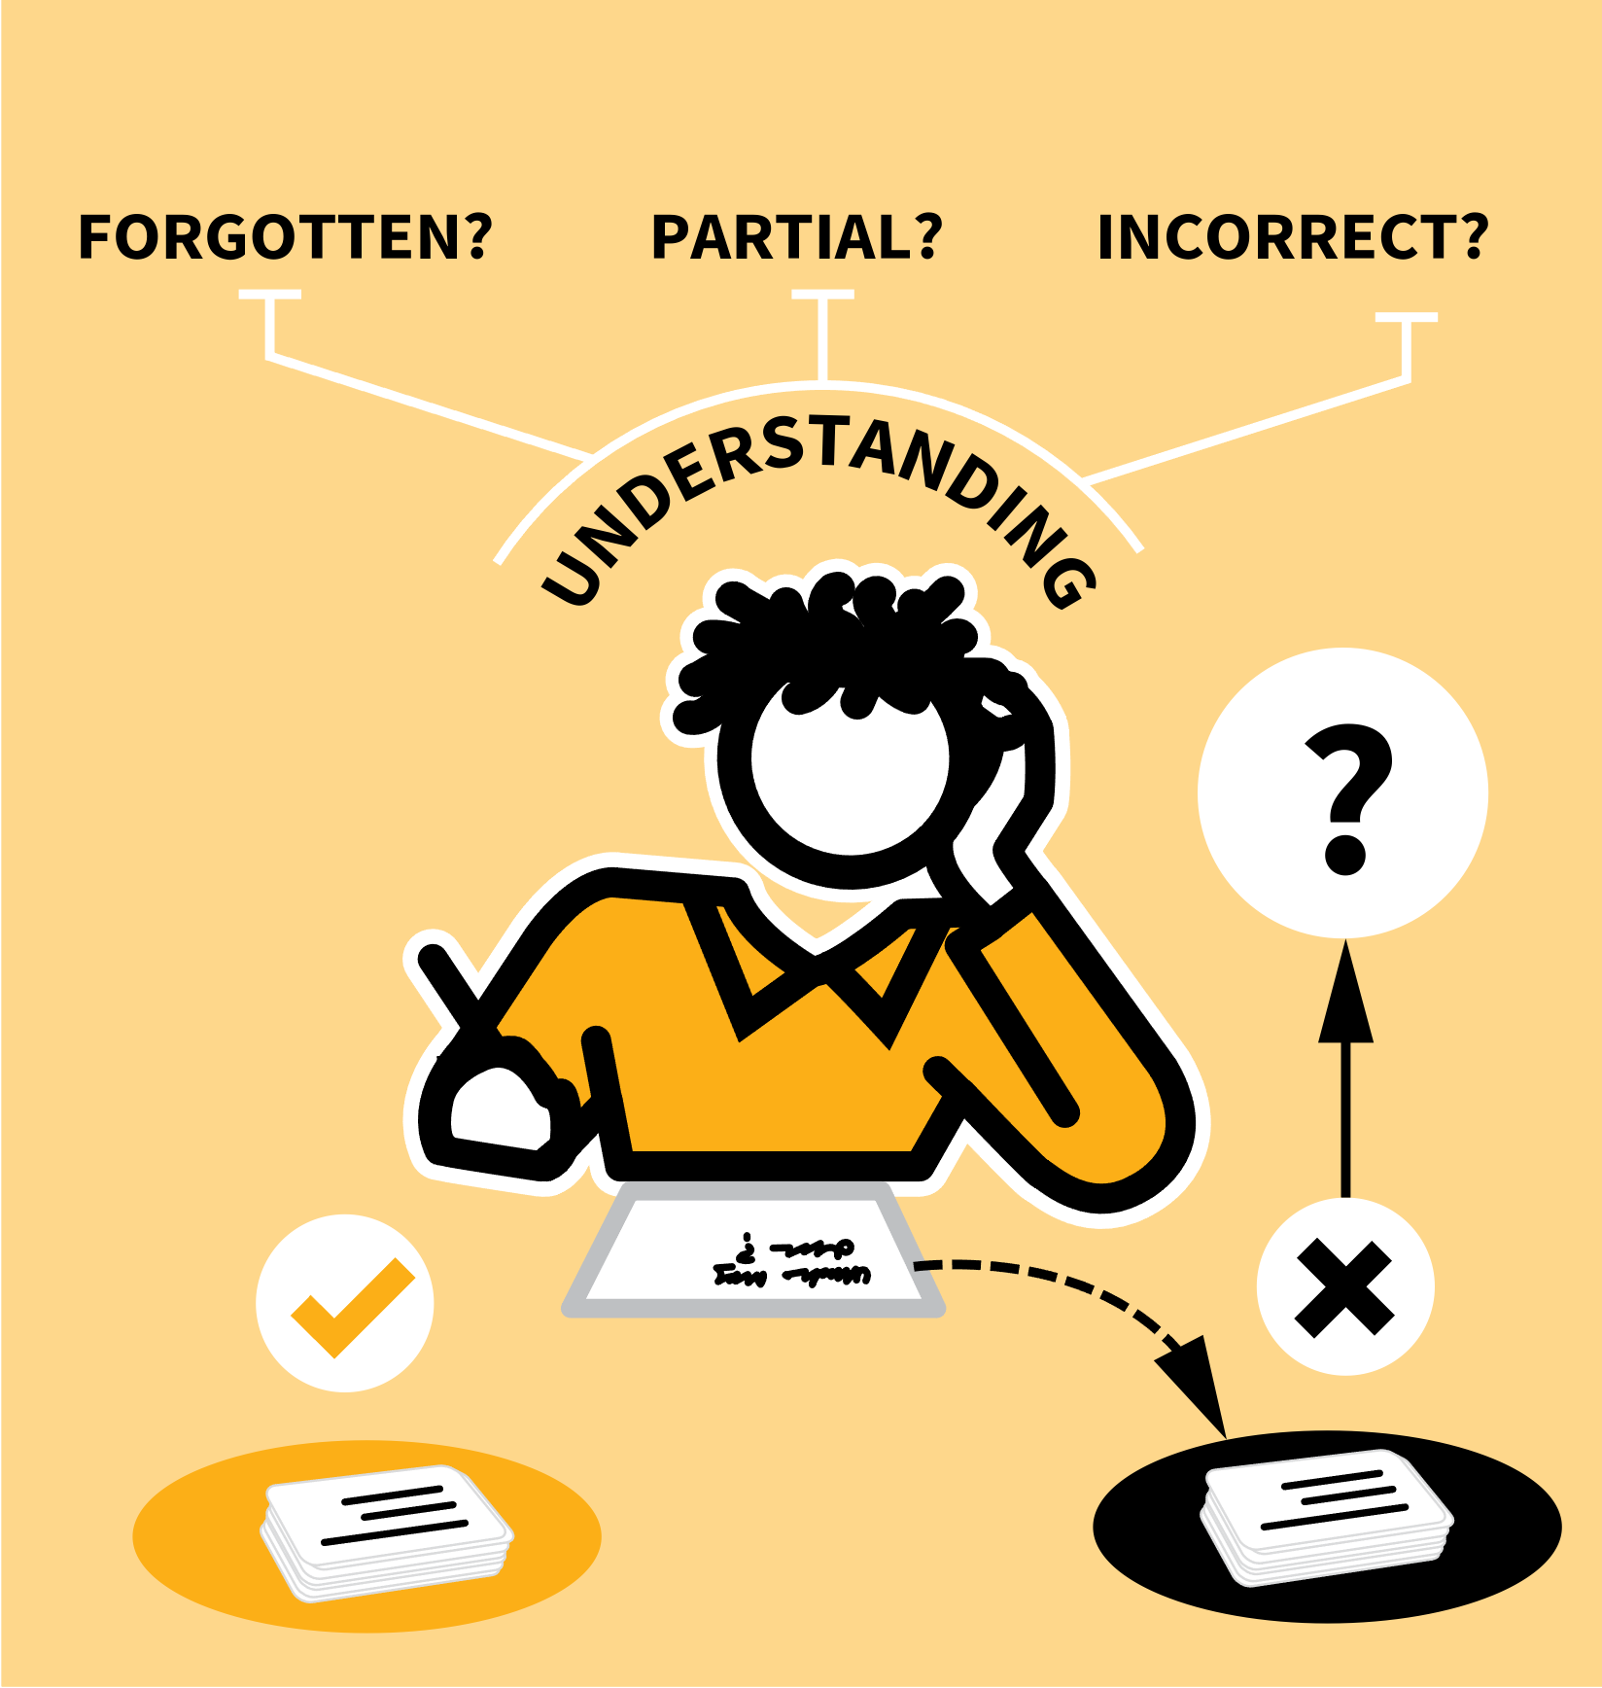
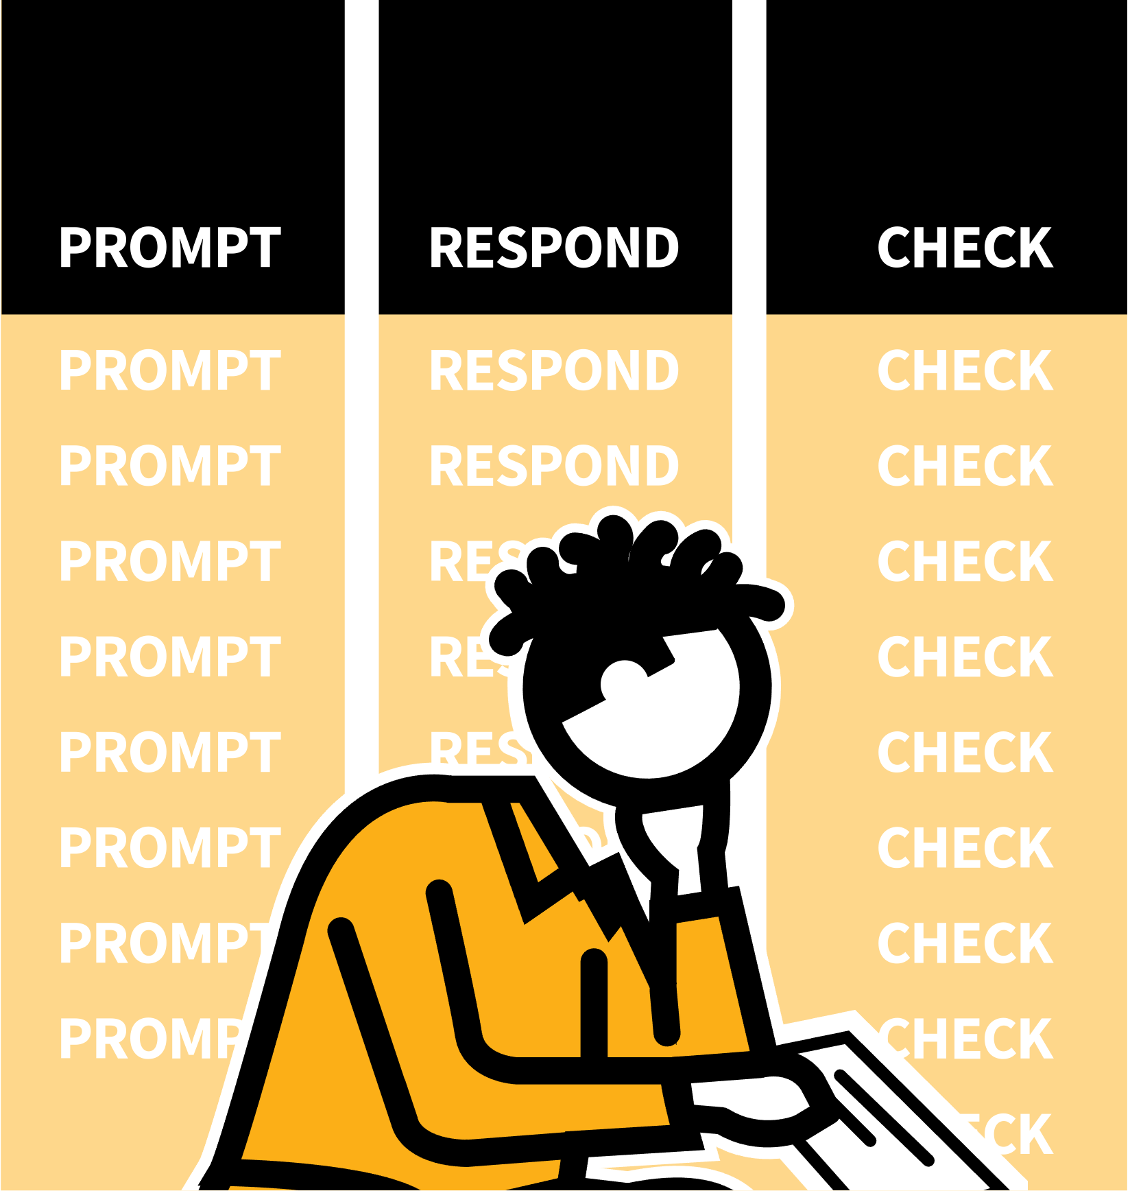
LEARNING WALKTHRUs
STUDY HABITS & TECHNIQUES SERIES
USING FLASH CARDS
1
2
3
4
5
GATHER A SET OF FLASH CARDS & CHECK YOUR UNDERSTANDING
RUN THROUGH THE SET
EXPLORE YOUR WRONG OR INCOMPLETE RESPONSES
RERUN THE WRONG ANSWERS
SHUFFLE & RETEST AT INTERVALS
A popular tool to support revision of factual knowledge is a set of flash cards. These can be physical cards to hold in your hands or digital versions to use online.
A good flash card has a prompt on one side that requires you to think of a specific answer or requires you to elaborate with multiple details or give an explanation.
After generating your response, flip the card over to see the correct answer or what a good response should include.

Slide 3
LEARNING WALKTHRUs
1 | 2 | 3 | 4 | 5
STUDY HABITS & TECHNIQUES SERIES
GATHER A SET OF FLASH
CARDS & CHECK YOUR UNDERSTANDING
USING FLASH CARDS
You might be given some pre-made flash cards or be asked to make your own. With your own, make sure prompts are appropriate for quizzing a specific topic and the answers are correct.
Check through each card so the prompt and response make sense. If you don’t understand the answers, there’s not much point in trying to memorise them.
Use the cards to check your understanding.

Slide 4
LEARNING WALKTHRUs
1 | 2 | 3 | 4 | 5
STUDY HABITS & TECHNIQUES SERIES
USING FLASH CARDS
RUN THROUGH THE SET
The routine for using flash cards is:
PROMPT | Look only at the prompt side of the card.
RESPOND | Produce the response required, saying it out loud or rehearsing mentally.
CHECK | After each response, flip the card to see the correct version.
Evaluate how well you did.

Slide 5
LEARNING WALKTHRUs
1 | 2 | 3 | 4 | 5
STUDY HABITS & TECHNIQUES SERIES
USING FLASH CARDS
EXPLORE YOUR WRONG OR INCOMPLETE RESPONSES
As you go through the cards separate them into two piles: those you got right and those you got wrong or where you missed things out.
Review the error pile. Study them again and work out where you went wrong.
If you just forgot something you understand then rehearse it; make connections to other similar facts.
If you don’t understand, go back to your notes, look at examples or ask your teacher.

Slide 6
LEARNING WALKTHRUs
1 | 2 | 3 | 4 | 5
STUDY HABITS & TECHNIQUES SERIES
RERUN THE WRONG
ANSWERS
USING FLASH CARDS
Once you’ve reviewed the answers run through the error pile again.
Follow the same pattern one card at a time: PROMPT | RESPOND | CHECK
Again, add your correct answers to the original correct pile and make a new error pile.
Repeat the process.
Keep focused on the error pile until you can get a correct response to every card.

Slide 7
LEARNING WALKTHRUs
1 | 2 | 3 | 4 | 5
STUDY HABITS & TECHNIQUES SERIES
USING FLASH CARDS
SHUFFLE & RETEST AT INTERVALS
Some hours or days after your previous run-through, return to the same flash cards.
Shuffle them up and go through the whole pile again. If you’ve properly learned the material, the error pile will be smaller each time.
With repetition spread out over days and weeks, you’ll find that the knowledge becomes much easier to remember; your fluency with the facts will increase.

