Slide 1
The Bathurst Way
How to revise
Free Recall

Slide 2
LEARNING WALKTHRUs
1 | 2 | 3 | 4 | 5
STUDY HABITS & TECHNIQUES SERIES
OPEN RECALL AKA BRAIN DUMPS
SELECT A TOPIC &
RELATED PROMPT
Prompt your open recall with a key word or a question. The prompt you choose will guide your subsequent recall, e.g.
WAVES |
Broad prompt to explore the general properties of various types of waves.
USES OF THE E-M SPECTRUM |
Focused prompt leads you to drill into applications of radio, microwaves, UV and infrared light.

Slide 3
LEARNING WALKTHRUs
1 | 2 | 3 | 4 | 5
STUDY HABITS & TECHNIQUES SERIES
WRITE DOWN KEY
CONCEPTS IN A
FREE-FLOWING MANNER
OPEN RECALL AKA BRAIN DUMPS
Using a blank sheet, write the prompt in the centre; write down related ideas as they come to you.
Don’t worry about organising the information too much at first; let the ideas flow. Jot them down.
If you see a natural place to add an idea, linking up with something else, do that as you go along.
Avoid eliminating ideas too quickly — if at first your open recall leads you to something relatively obscure or disconnected, let that happen.

Slide 4
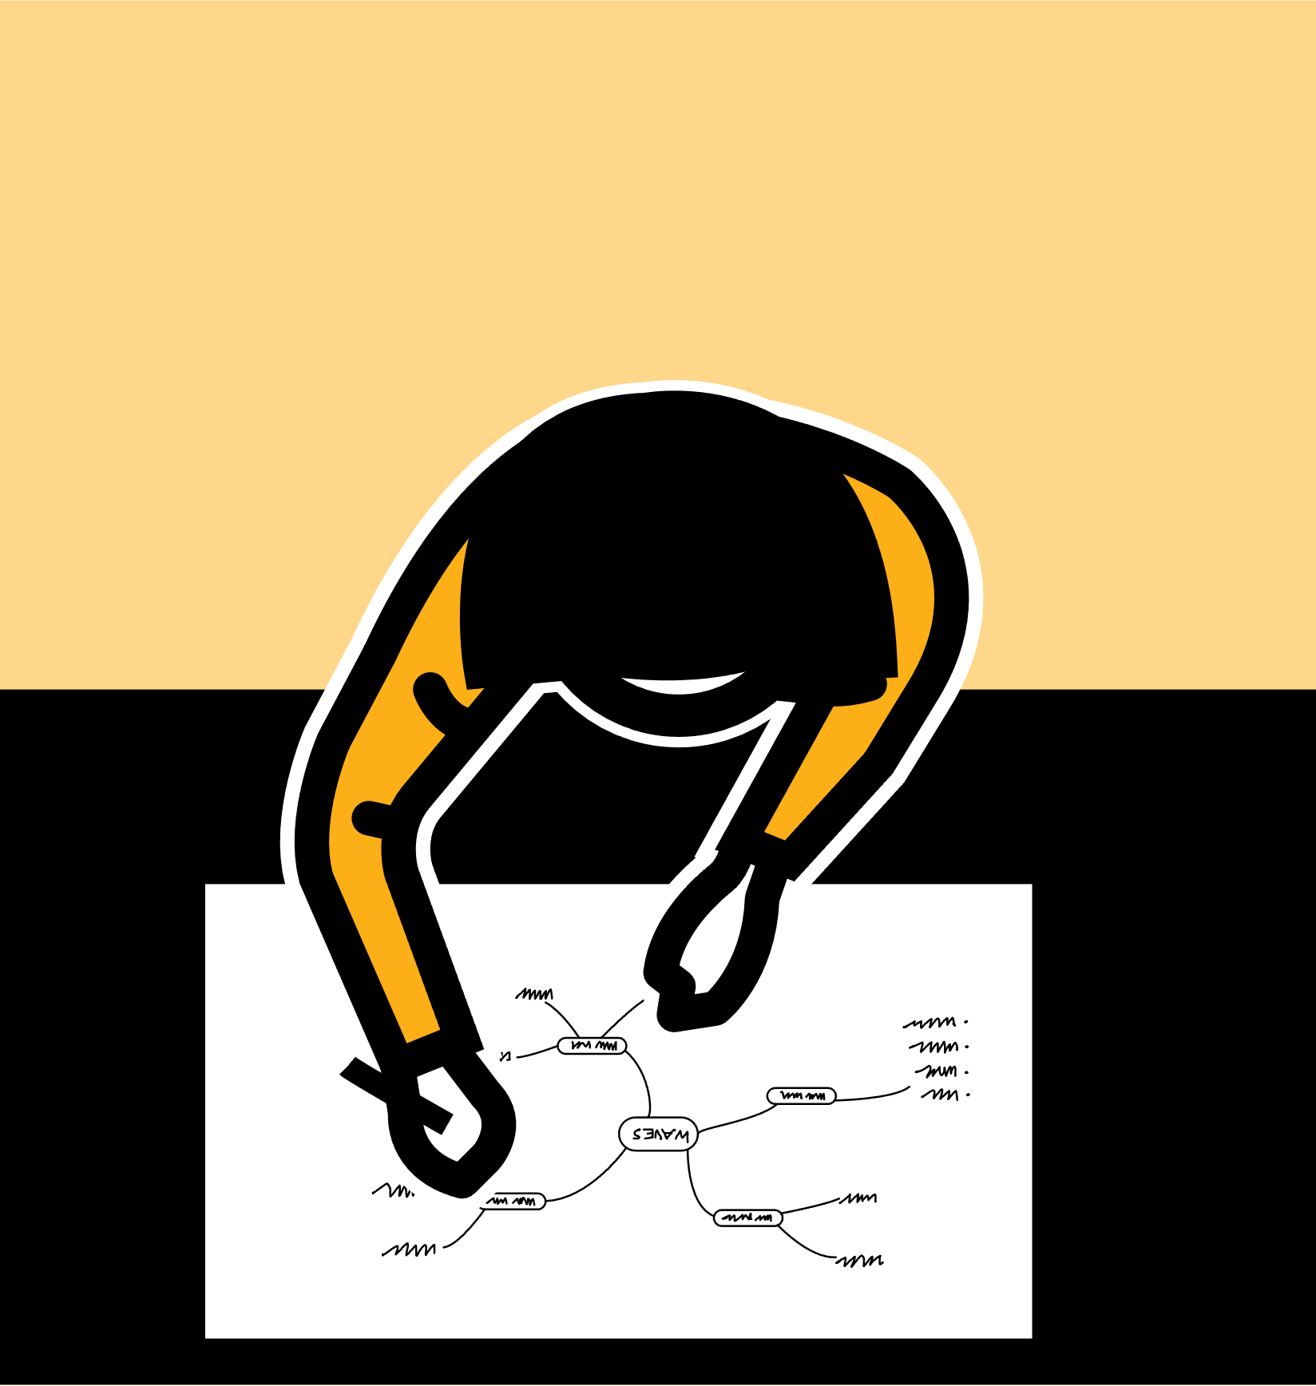
LEARNING WALKTHRUs
1 | 2 | 3 | 4 | 5
STUDY HABITS & TECHNIQUES SERIES
OPEN RECALL AKA BRAIN DUMPS
ORGANISE & CONNECT
IDEAS
When you’ve covered the topic in detail, or recorded a large number of ideas, stop to take stock of what you’ve got.
Make links between relevant sections — perhaps showing them with lines and arrows.
Reorganise information into categories or sections so ideas are easier to make sense of.
Record your free-flow brain dump very roughly then perhaps a second more organised copy.

Slide 5
LEARNING WALKTHRUs
1 | 2 | 3 | 4 | 5
STUDY HABITS & TECHNIQUES SERIES
OPEN RECALL AKA BRAIN DUMPS
CHECK ACCURACY
& IDENTIFY GAPS
Be aware of mistakes and gaps. You want to address or correct them.
Having made your open-recall record from memory, go back to your notes or resources related to the same topic:
Have you made any mistakes?
Have you left anything out that should have been included?
Amend the record so that it’s now more complete.

Slide 6
LEARNING WALKTHRUs
1 | 2 | 3 | 4 | 5
STUDY HABITS & TECHNIQUES SERIES
EXTEND DEPTH &
RANGE OF IDEAS
OPEN RECALL AKA BRAIN DUMPS
Once you’ve completed an open-recall process you’re satisfied with, go further.
Zoom in on one area to explore your knowledge at a deeper level — remembering more specific ideas that branch off from what you have so far.
e.g. The way microwaves are used in telecommunications and how satellites work.
Or expand your open recall into other related areas,
e.g. explore sound and hearing.

