Slide 1
The Bathurst Way
How to revise

Slide 2
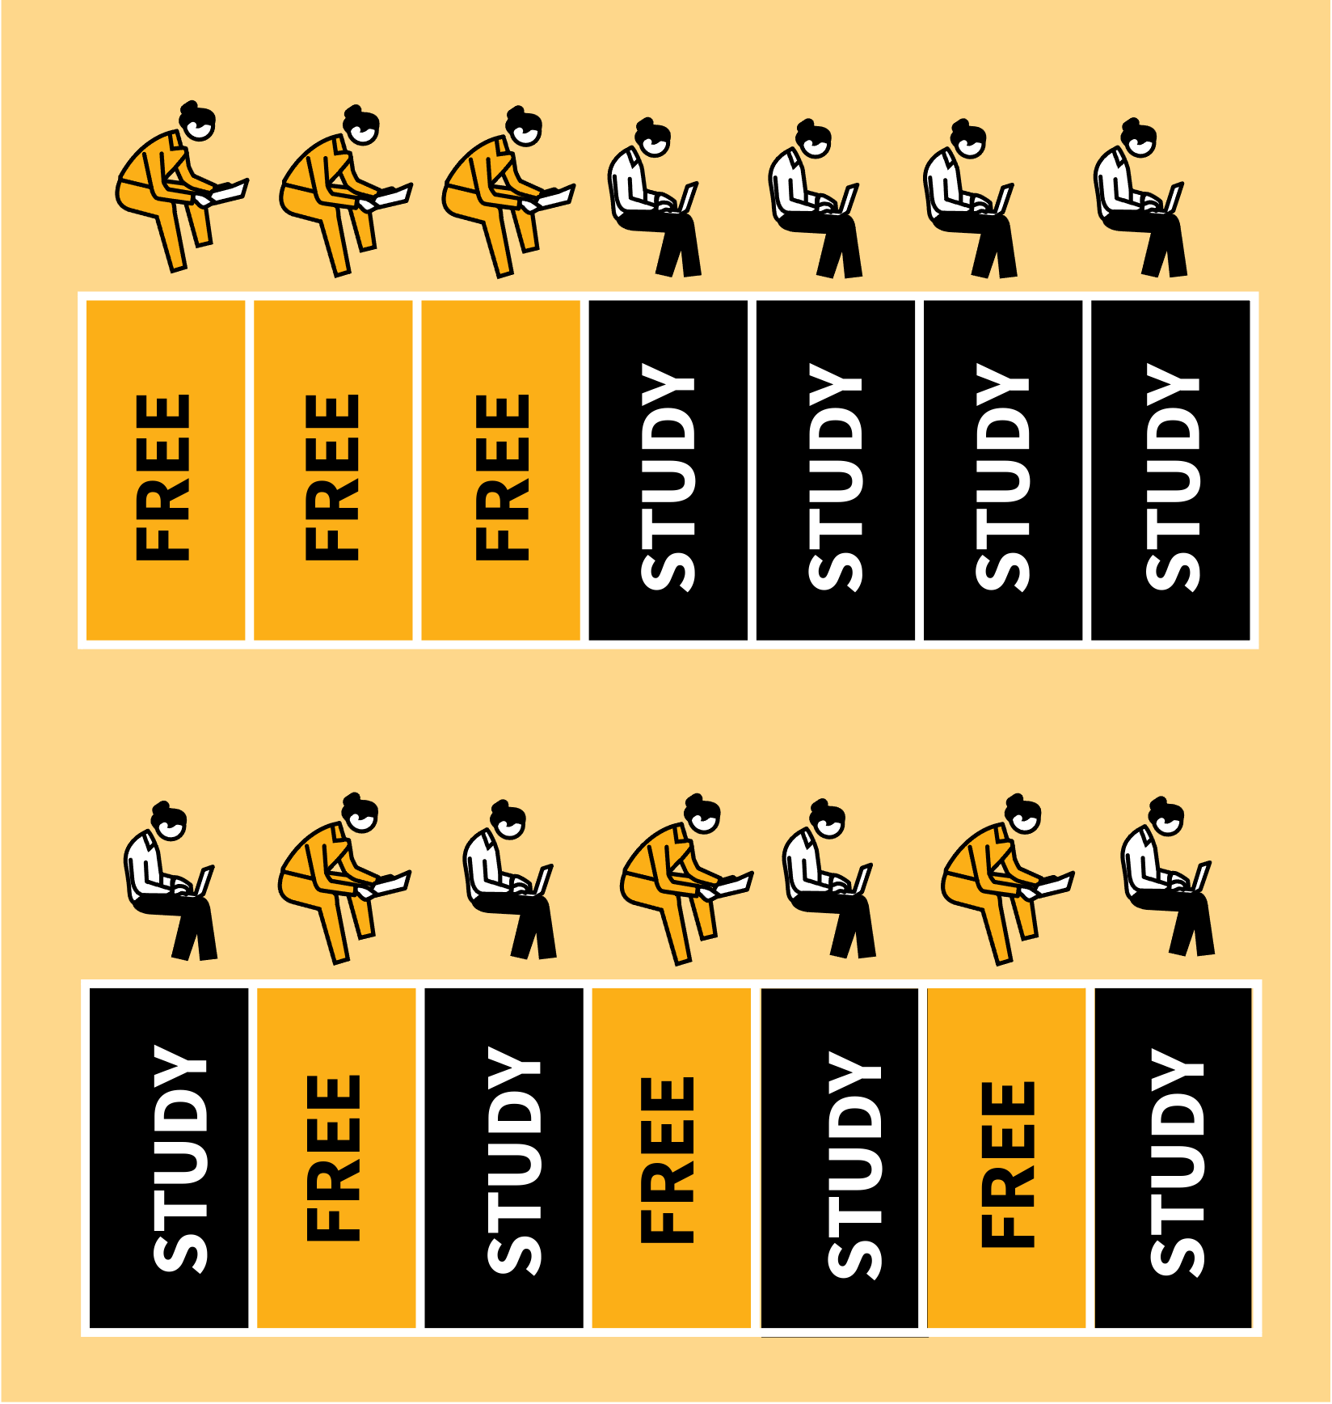
SPACING & INTERLEAVING
These interconnected ideas have been researched extensively by cognitive scientists:
Spacing | Revisiting material in short sessions with days or weeks between, perhaps at regular intervals, is more effective than doing one long study session. You form stronger connections, making it easier to remember what you learned.
Interleaving | Studying a mix of closely related subtopics during any session is more effective than only focusing on one subtopic at a time.
LEARNING WALKTHRUs

Slide 3
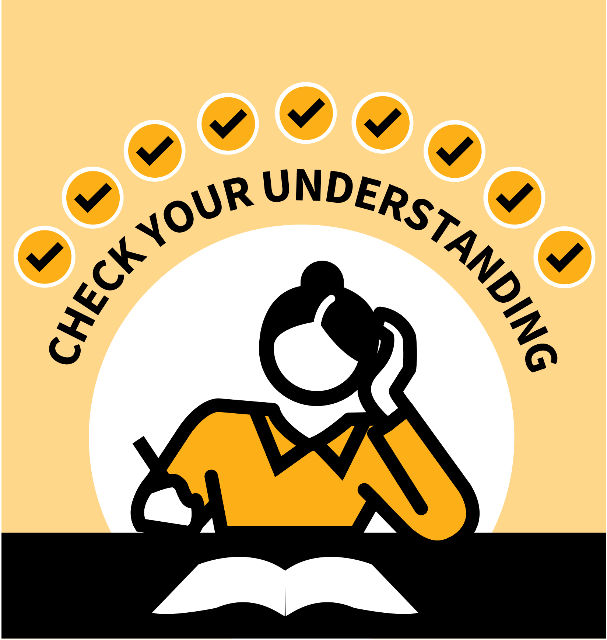
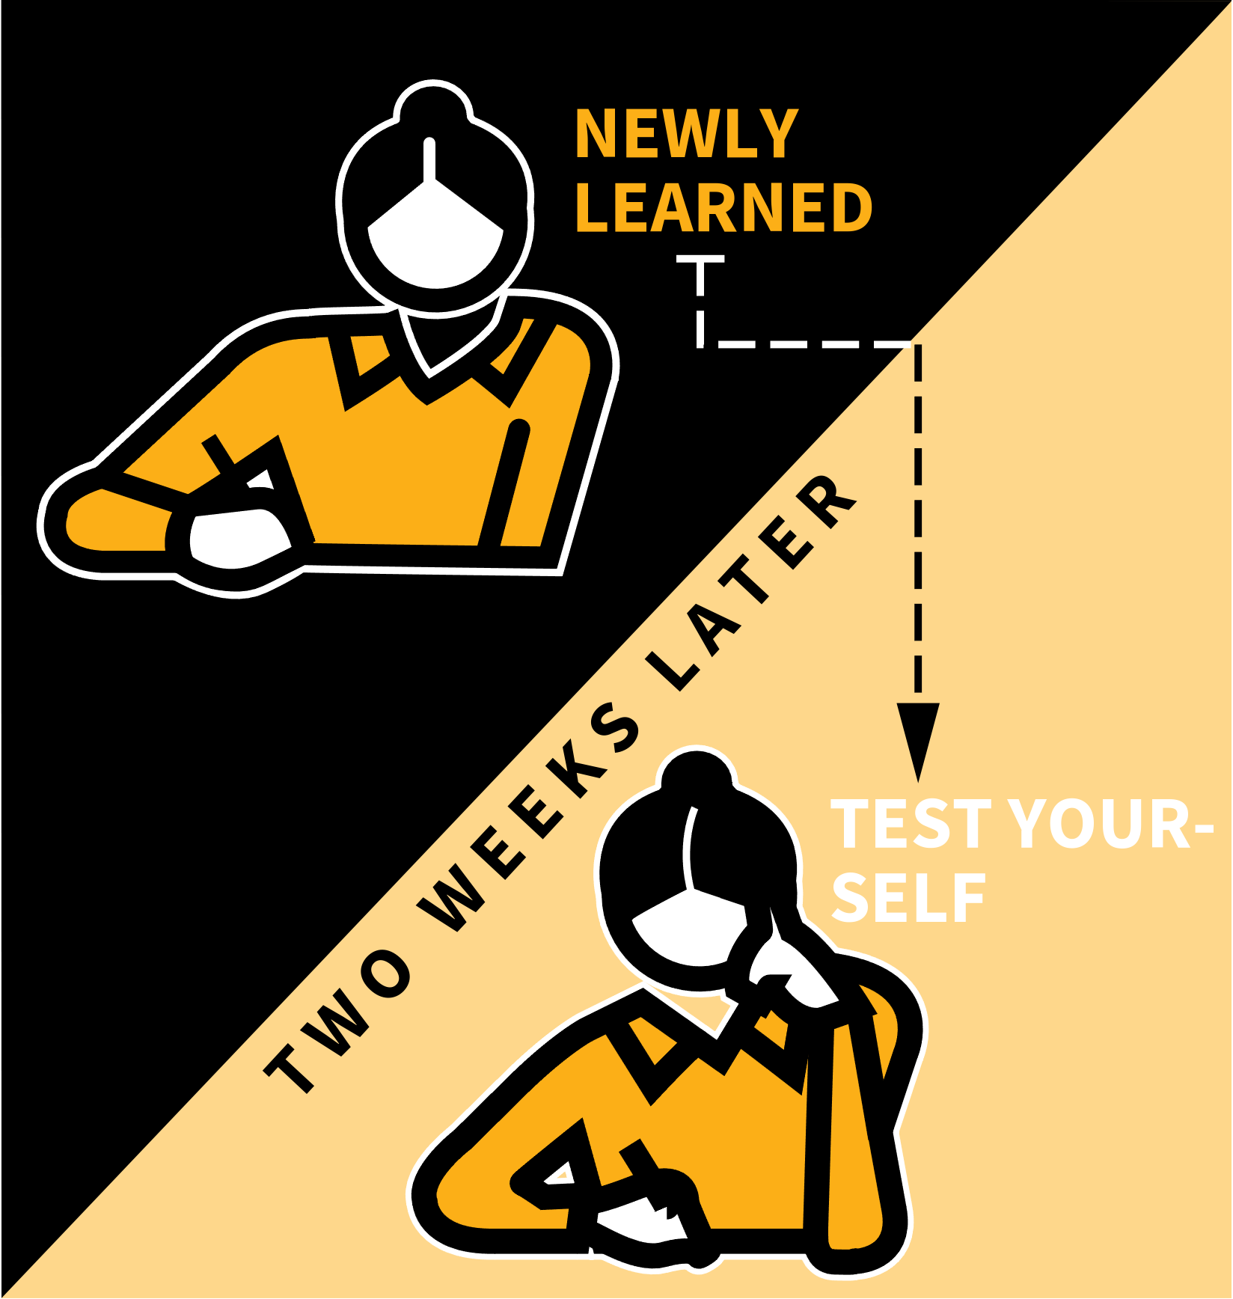
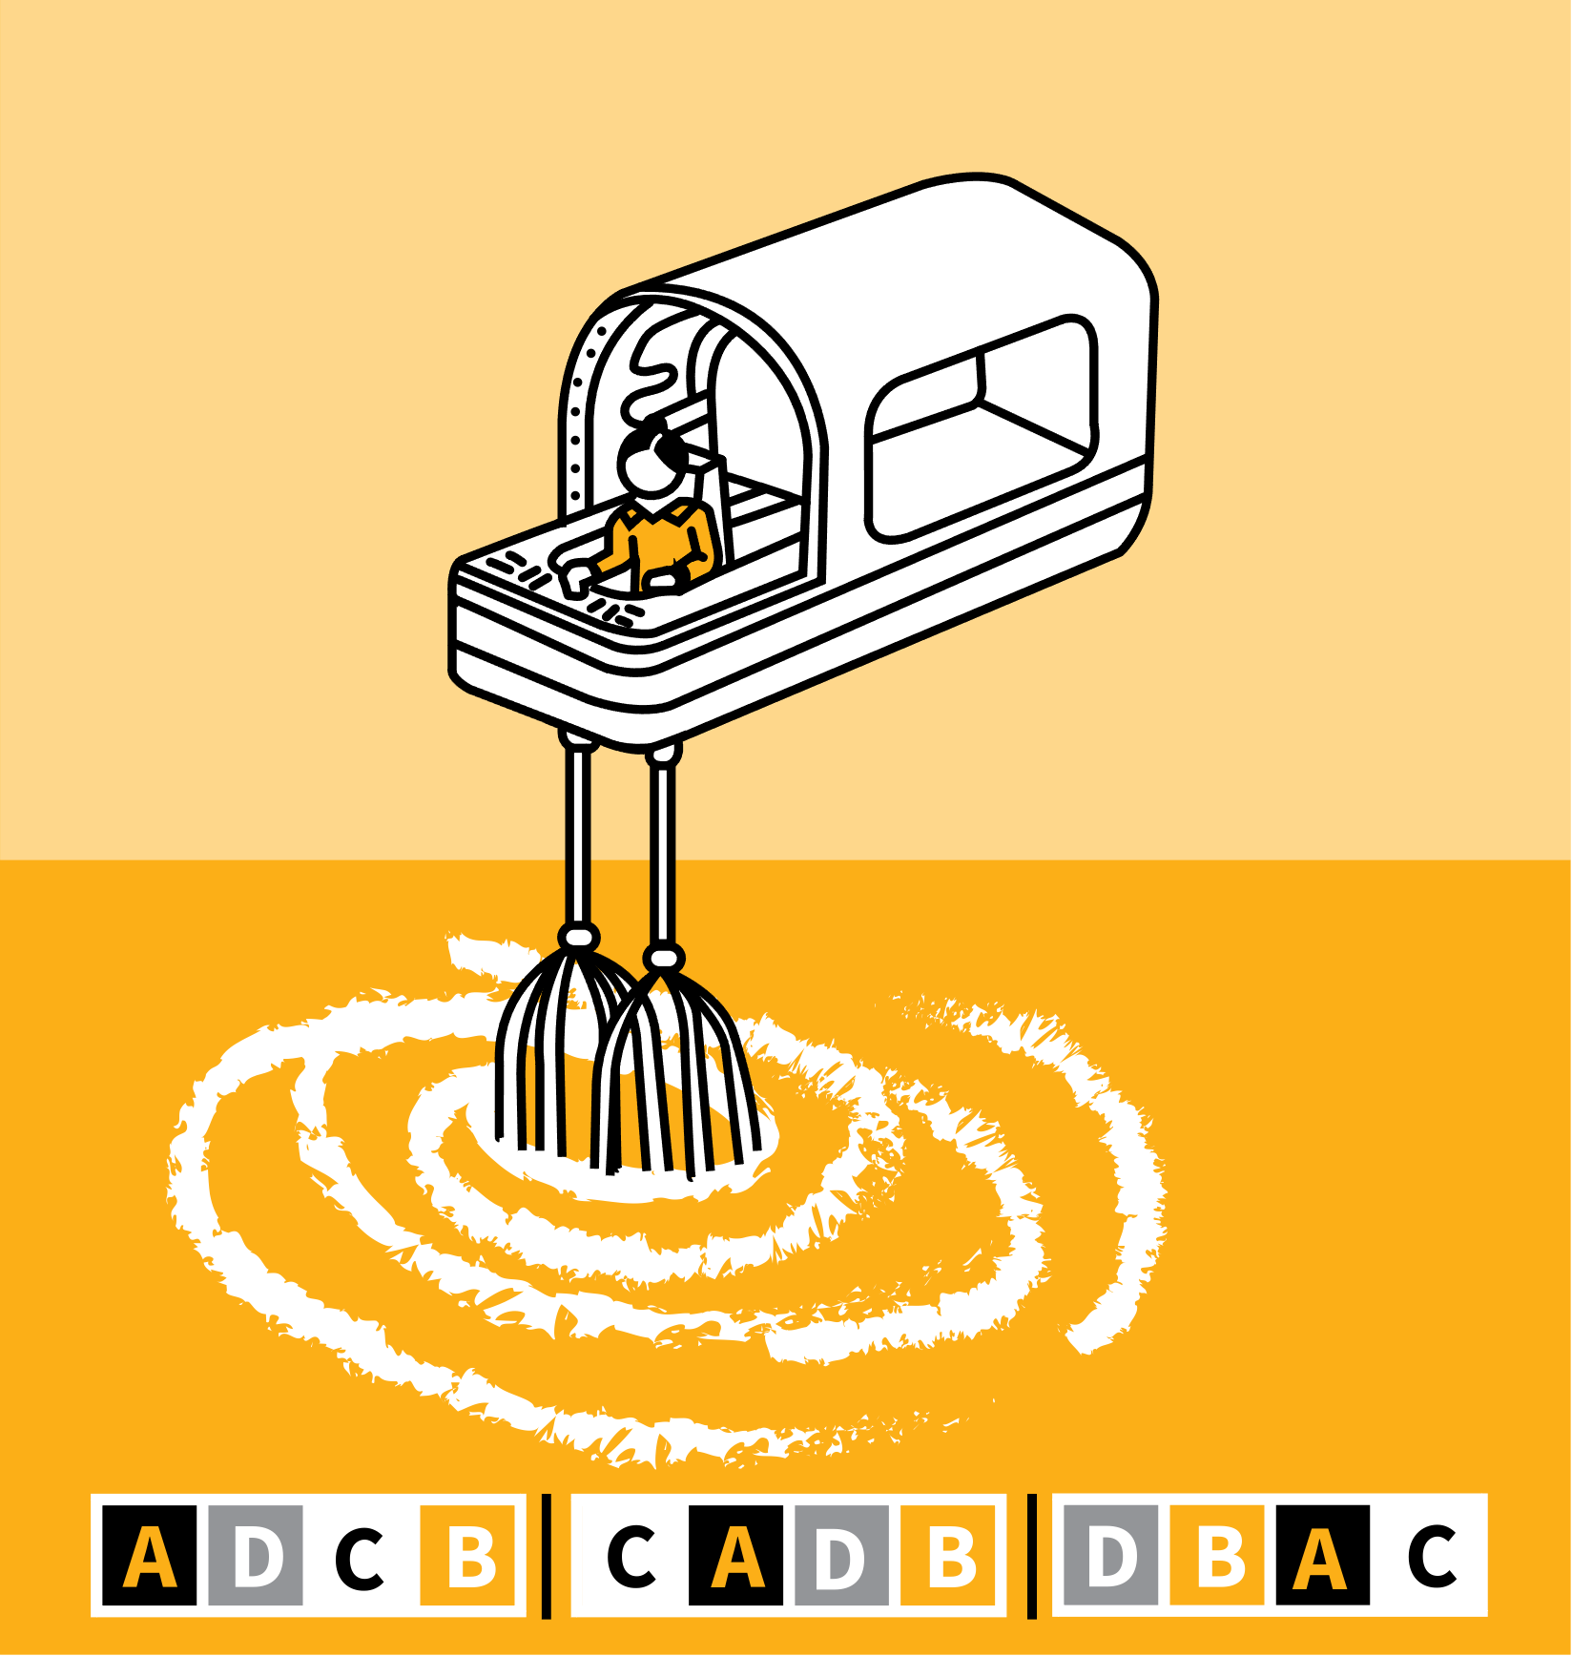
LEARNING WALKTHRUs
STUDY HABITS & TECHNIQUES SERIES
SPACING & INTERLEAVING
1
2
3
4
5
STUDY THE MATERIAL; CHECK YOUR UNDERSTANDING
SPACE PRACTICE DURING LEARNING
SPACE PRACTICE DURING REVISION
INTERLEAVING | MIX UP THE TOPIC RANGE
BUILD THESE IDEAS INTO YOUR REVISION STRATEGY
These interconnected ideas have been researched extensively by cognitive scientists:
SPACING | Revisiting material in short sessions with days or weeks between, perhaps at regular intervals, is more effective than doing one long study session. You form stronger connections, making it easier to remember what you learned.
INTERLEAVING | Studying a mix of closely related subtopics during any session is more effective than only focusing on one subtopic at a time.

Slide 4
LEARNING WALKTHRUs
1 | 2 | 3 | 4 | 5
STUDY HABITS & TECHNIQUES SERIES
STUDY THE MATERIAL;
CHECK YOUR UNDERSTANDING
SPACING & INTERLEAVING
Spacing and interleaving help you to strengthen your ability to remember things you’ve learned and to make connections between them.
However, first, make sure you understand the ideas as deeply as possible. Check your understanding with Self-Quizzing or Practise Explaining
Identify areas that don’t make sense to you. Use your study resources to clarify or ask your teacher to explain those ideas again.

Slide 5
LEARNING WALKTHRUs
1 | 2 | 3 | 4 | 5
STUDY HABITS & TECHNIQUES SERIES
SPACING & INTERLEAVING
SPACE PRACTICE DURING LEARNING
After encountering new concepts or words, revisit them within a few days or weeks. You can forget things quickly but short follow-up study sessions can consolidate knowledge so it stays with you a lot longer.
Test yourself with Self-Quizzing or Using Flash Cards and explore any weak areas.
Spacing your practice this way adds some difficulty to your routines but really pays off.

Slide 6
LEARNING WALKTHRUs
1 | 2 | 3 | 4 | 5
STUDY HABITS & TECHNIQUES SERIES
SPACING & INTERLEAVING
SPACE PRACTICE DURING REVISION
When you’re coming up to a test some weeks or months after you first learned the topics, you need to plan a schedule of revision.
Researchers suggest revising a topic for, say, 30 minutes every day for five days is more effective than studying in a block of two and a half hours.
The gaps between sessions allow you to process and consolidate what you’ve learned far better than trying to do it all in one go.

Slide 7
LEARNING WALKTHRUs
1 | 2 | 3 | 4 | 5
STUDY HABITS & TECHNIQUES SERIES
SPACING & INTERLEAVING
INTERLEAVING | MIX UP
THE TOPIC RANGE
Studying a subject with multiple subtopics, you may want to focus on one topic for a whole session.
However, in fact, the additional difficulty of mixing up the topics can actually improve your future recall. This is called interleaving.
e.g. in maths, instead of focusing on questions all of one type, then another type, then another, you stretch yourself by mixing up the questions.
This helps you later, even if it’s harder at the time.

Slide 8
LEARNING WALKTHRUs
1 | 2 | 3 | 4 | 5
STUDY HABITS & TECHNIQUES SERIES
SPACING & INTERLEAVING
BUILD THESE IDEAS INTO YOUR REVISION STRATEGY
Take account of these ideas to plan an effective study schedule. You might:
Use a daily two-hour study session to study 3-4 subjects for half an hour each, instead of focusing on just one.
Plan a review session a couple of weeks after first learning new material, to consolidate and check gaps.
Mix up questions from different subtopics within a unit as you get closer to a test.

