Slide 1


The Bathurst Way
How to revise
Mapping and word diagrams

Slide 2

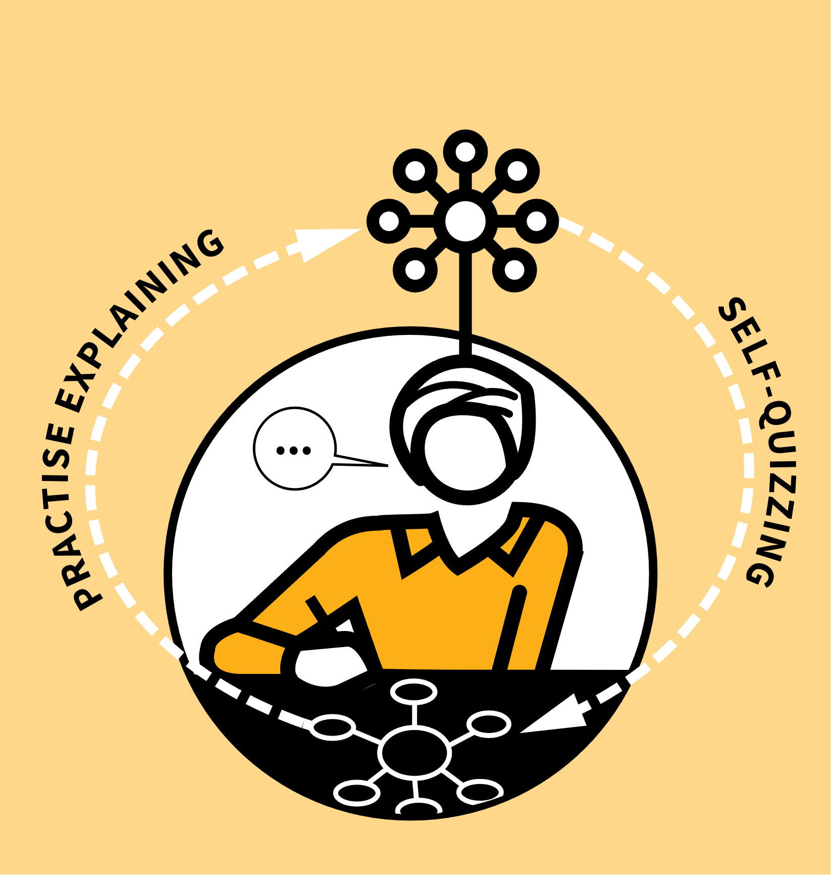
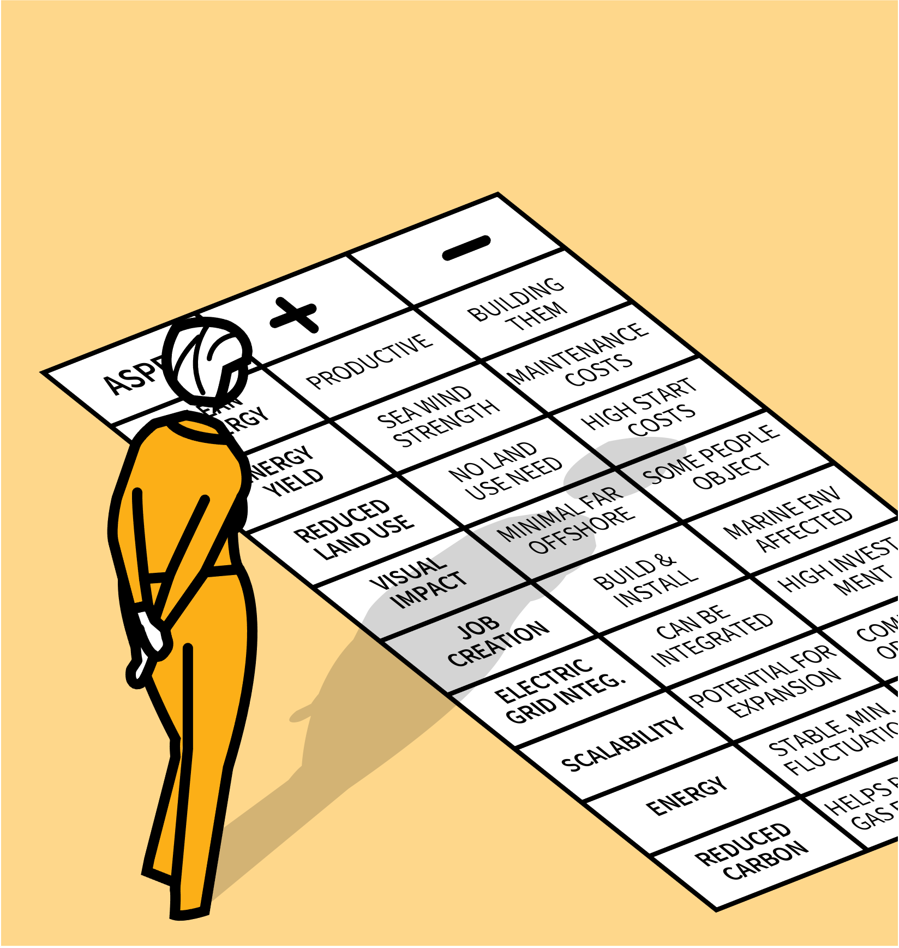
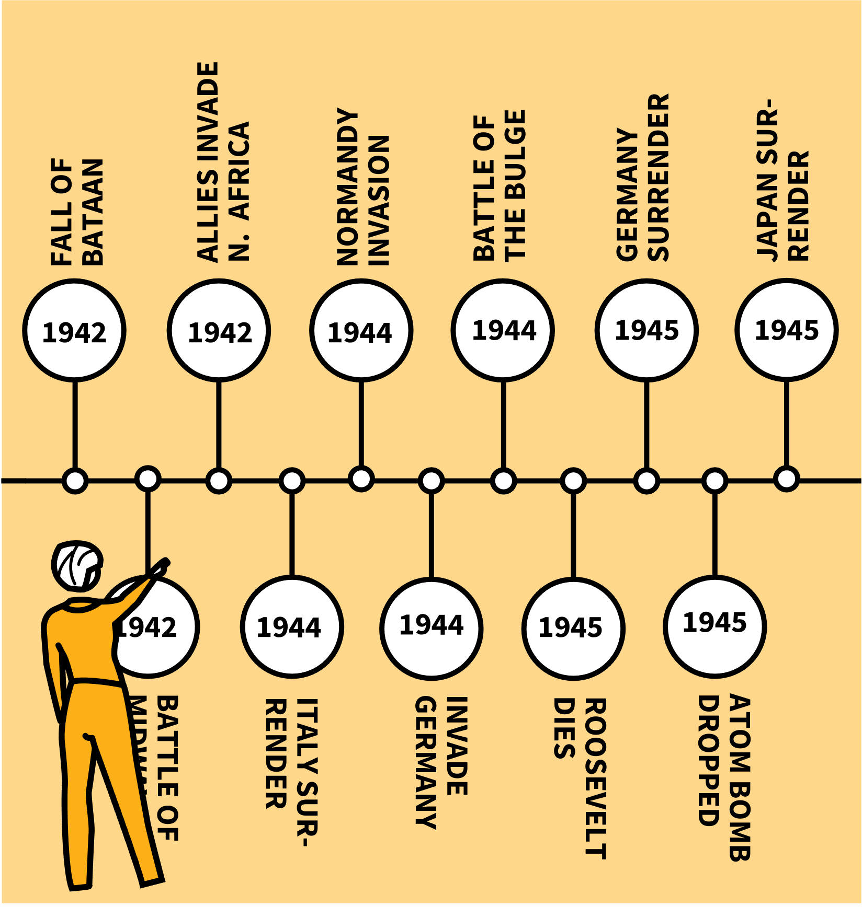
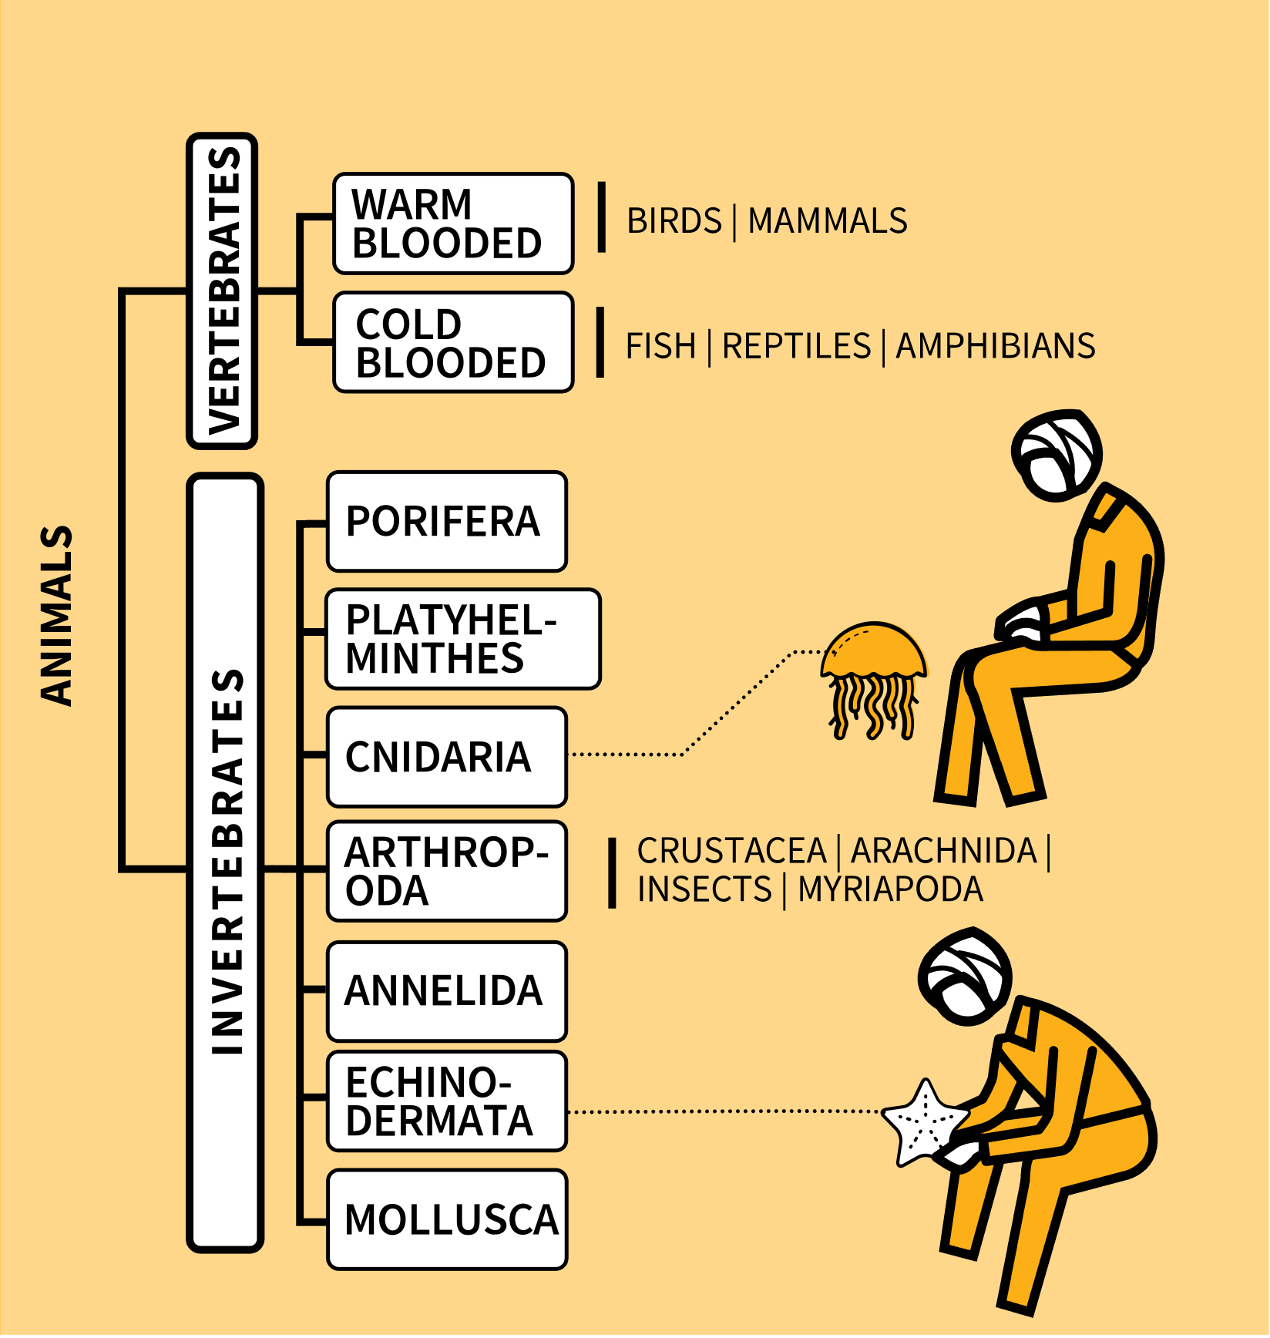
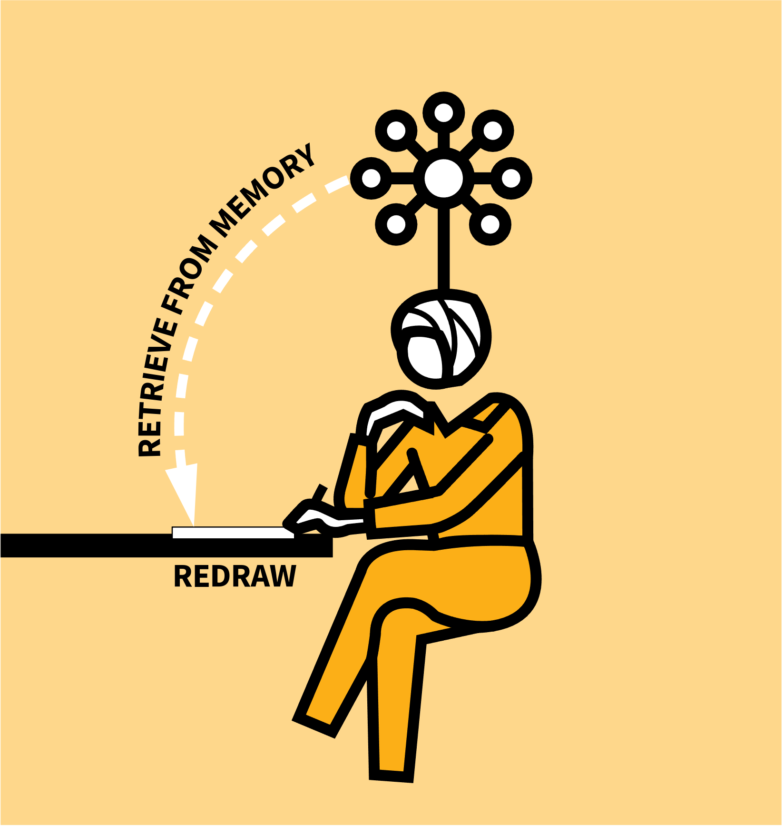
LEARNING WALKTHRUs
STUDY HABITS & TECHNIQUES SERIES
MAPPING | WORD DIAGRAMS
1
2
3
4
5
ORGANISE YOUR IDEAS DURING THE STUDY PHASE
CATEGORIES & COMPARISONS IN TABLES
SEQUENCES & TIMELINES
HIERARCHIES & BRANCHING TREES
RECREATE RELEVANT DIAGRAM & CHECK FOR ACCURACY
We can make sense of ideas with mental models that have a spatial element to the way we organise them. These models are often captured visually by the way we represent them on a page or screen.
Word diagrams can make lots of forms — simple lists, tables, hierarchies, flow charts or timelines. They can help us as we learn, helping to get ideas organised and to help us remember things. The more organised our ideas are, the easier it is to build on later.

Slide 3
LEARNING WALKTHRUs
1 | 2 | 3 | 4 | 5
STUDY HABITS & TECHNIQUES SERIES
ORGANISE YOUR IDEAS
DURING THE STUDY PHASE
MAPPING | WORD DIAGRAMS
Following examples modelled by your teachers, use your notebook to record ideas using the appropriate type of word diagram.
Run through information in your notes and use Self-Quizzing or Practise Explaining to check your understanding.
A neat-looking table or tree diagram is no use unless you can use it to explain the ideas it represents. Check you understand why each word or concept is in the place you’ve put it.

Slide 4
LEARNING WALKTHRUs
1 | 2 | 3 | 4 | 5
STUDY HABITS & TECHNIQUES SERIES
CATEGORIES &
COMPARISONS IN TABLES
MAPPING | WORD DIAGRAMS
A common form of word diagram is a table with two or more columns. Examples include:
  WORDS AND THEIR DEFINITIONS
e.g. metals and non-metals.
  ADVANTAGES AND DISADVANTAGES
e.g. of an onshore wind farm.
  COMPARING TWO OR MORE SIMILAR ITEMS | e.g. the features of plant and animal cells or two characters in Macbeth.

Slide 5
LEARNING WALKTHRUs
1 | 2 | 3 | 4 | 5
STUDY HABITS & TECHNIQUES SERIES
SEQUENCES &
TIMELINES
MAPPING | WORD DIAGRAMS
To show how ideas have an order in time, a flow diagram or a timeline might be useful:
  A TIMELINE IN HISTORY
historical events in time order with dates.
  A FLOW DIAGRAM IN D&T
the order to complete tasks to be successful.
  A SEQUENCE IN GEOGRAPHY
the order of events in how rocks are eroded by water to form rivers and valleys.

Slide 6
LEARNING WALKTHRUs
1 | 2 | 3 | 4 | 5
STUDY HABITS & TECHNIQUES SERIES
HIERARCHIES &
BRANCHING TREES
MAPPING | WORD DIAGRAMS
Hierarchies and tree diagrams show how broad ideas are broken down into more focused concepts or show relationships: e.g.
  Relationships between characters in a play.
  Categories of vertebrates and invertebrates in the animal kingdom.
  Concepts in an earthquake case study, starting with a few categories (social, environmental, economic) and branching into more fine details.

Slide 7
LEARNING WALKTHRUs
1 | 2 | 3 | 4 | 5
STUDY HABITS & TECHNIQUES SERIES
RECREATE THE
RELEVANT DIAGRAM &
CHECK FOR ACCURACY
MAPPING | WORD DIAGRAMS
With information recorded and understood, use diagrams to check how well you’ve learned the material. Produce them from memory:
  A table of the key characteristics of the characters in Animal Farm.
  A timeline of key events in World War II.
  A mind map organising ideas about the evidence for evolution.
Compare with your notes to check for accuracy and any key omissions.

