Slide 1
The Bathurst Way
How to revise
Self-quizzing

Slide 2
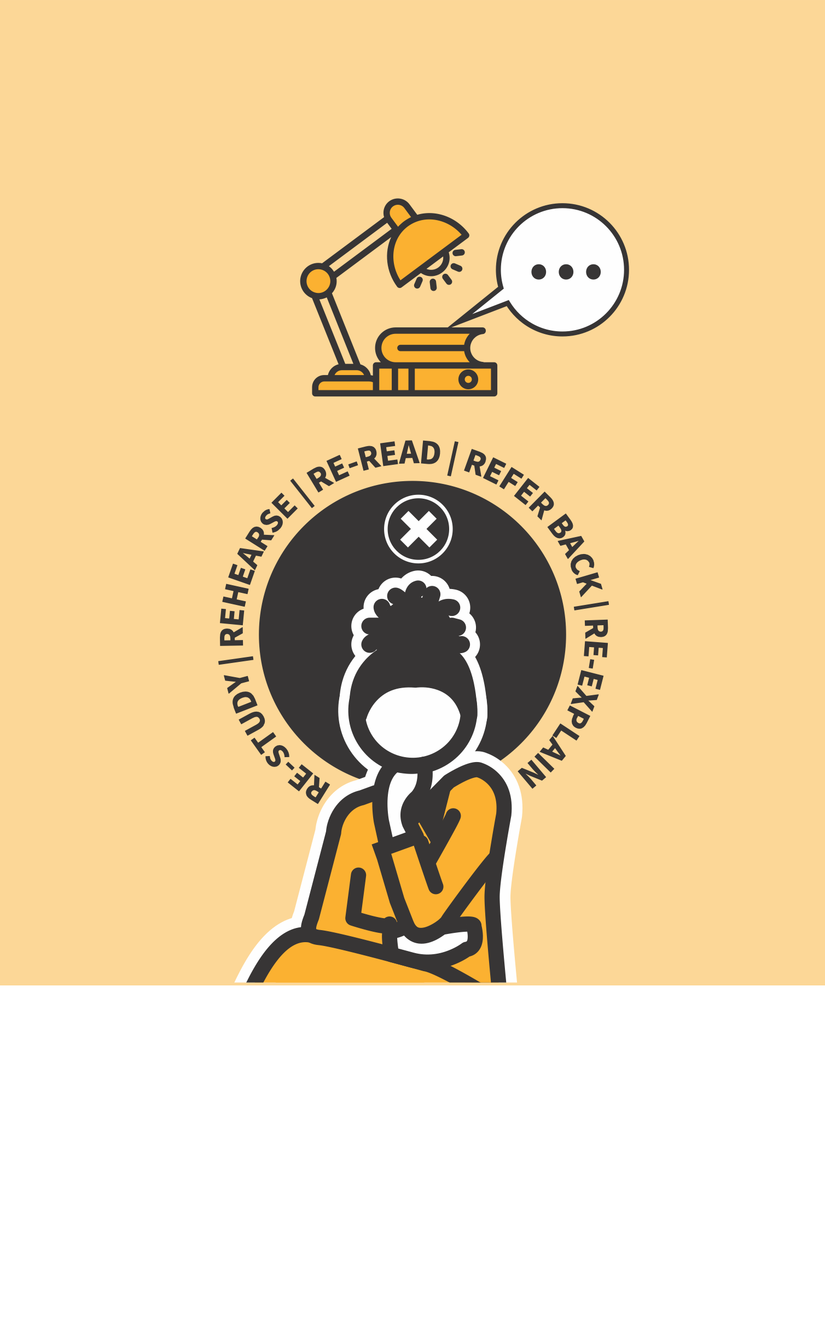
STUDY HABITS & TECHNIQUES
SELF-QUIZZING
01 | GATHER OR GENERATE QUIZ QUESTIONS
02 | ANSWER THE QUESTIONS UNAIDED
03 | CHECK YOUR ANSWERS
04 | IDENTIFY AREAS YOU NEED TO RE-STUDY
05 | TEST YOURSELF AGAIN. REPEAT
LEARNING WALKTHRUs

Slide 3
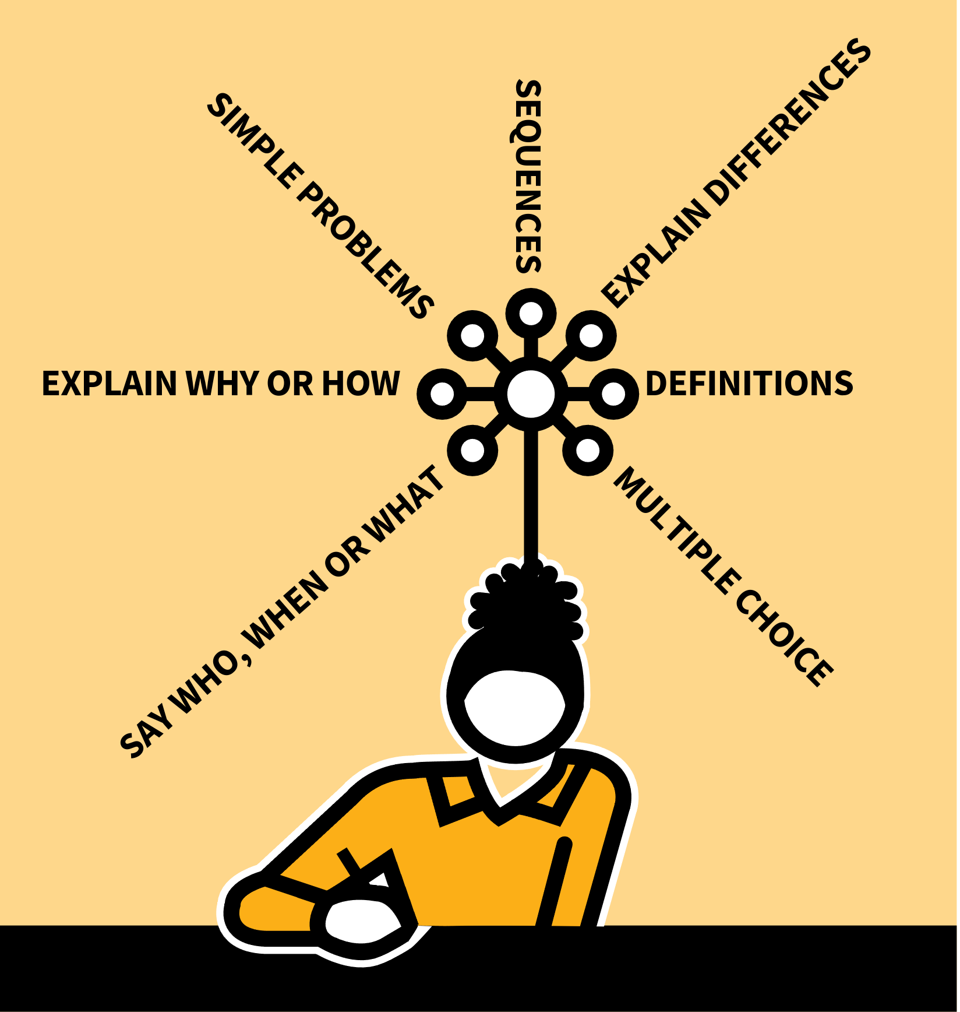
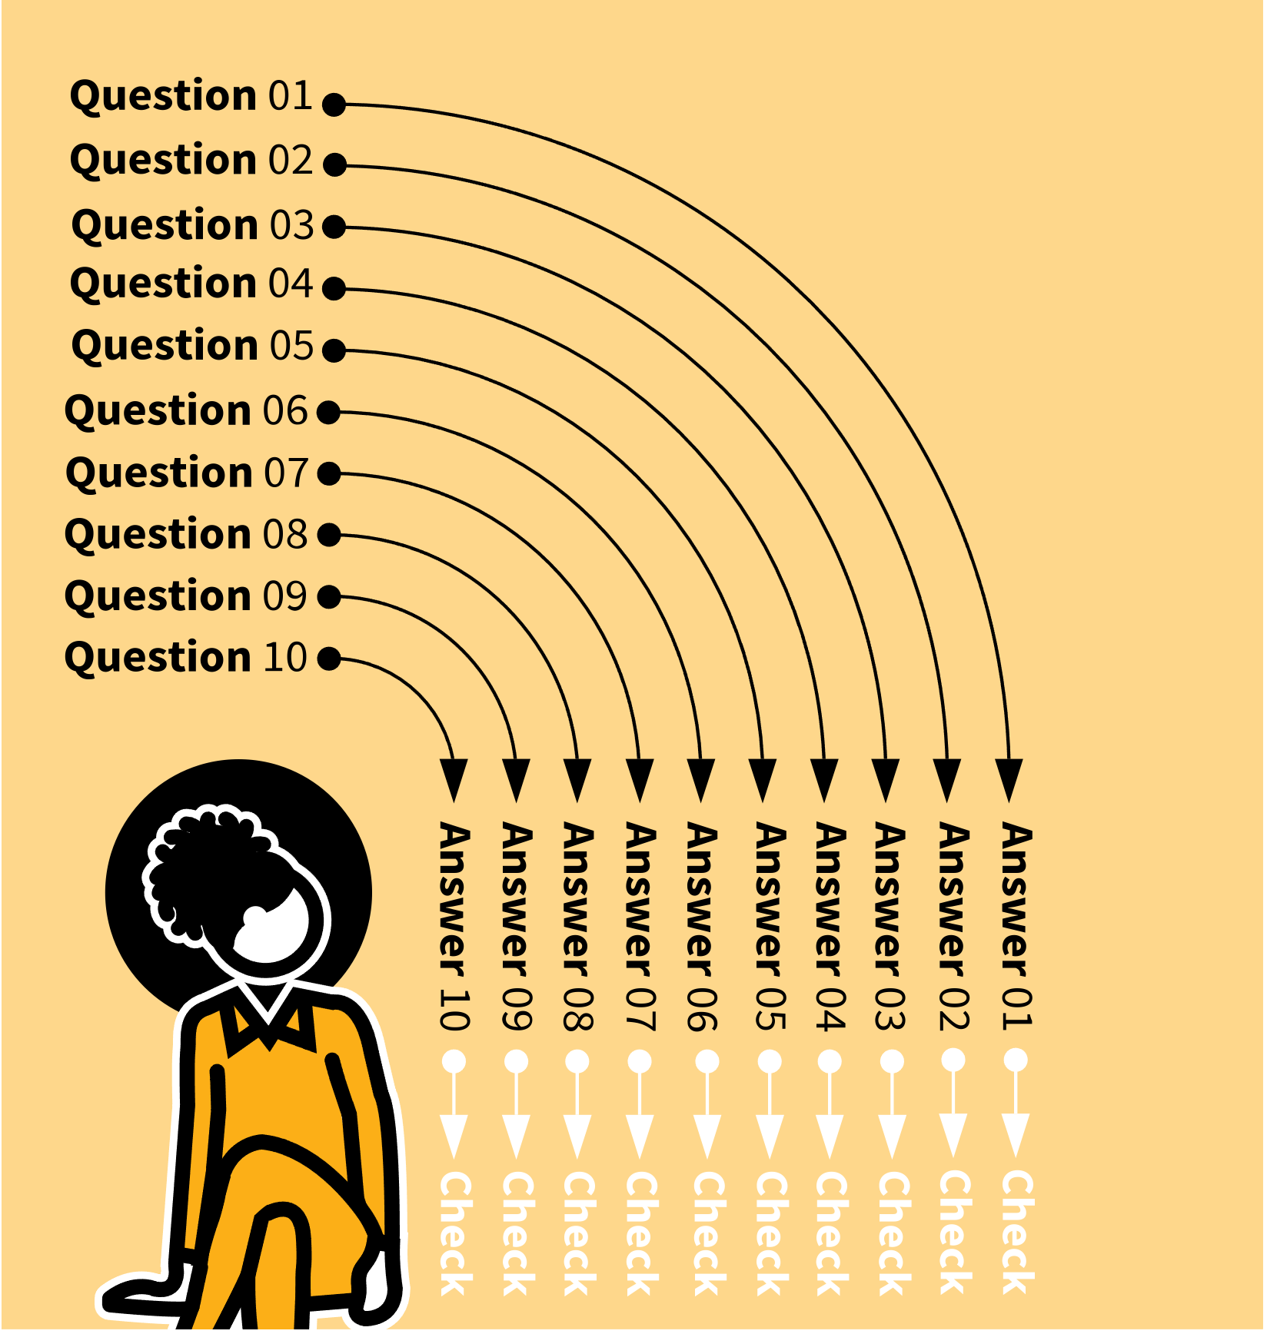
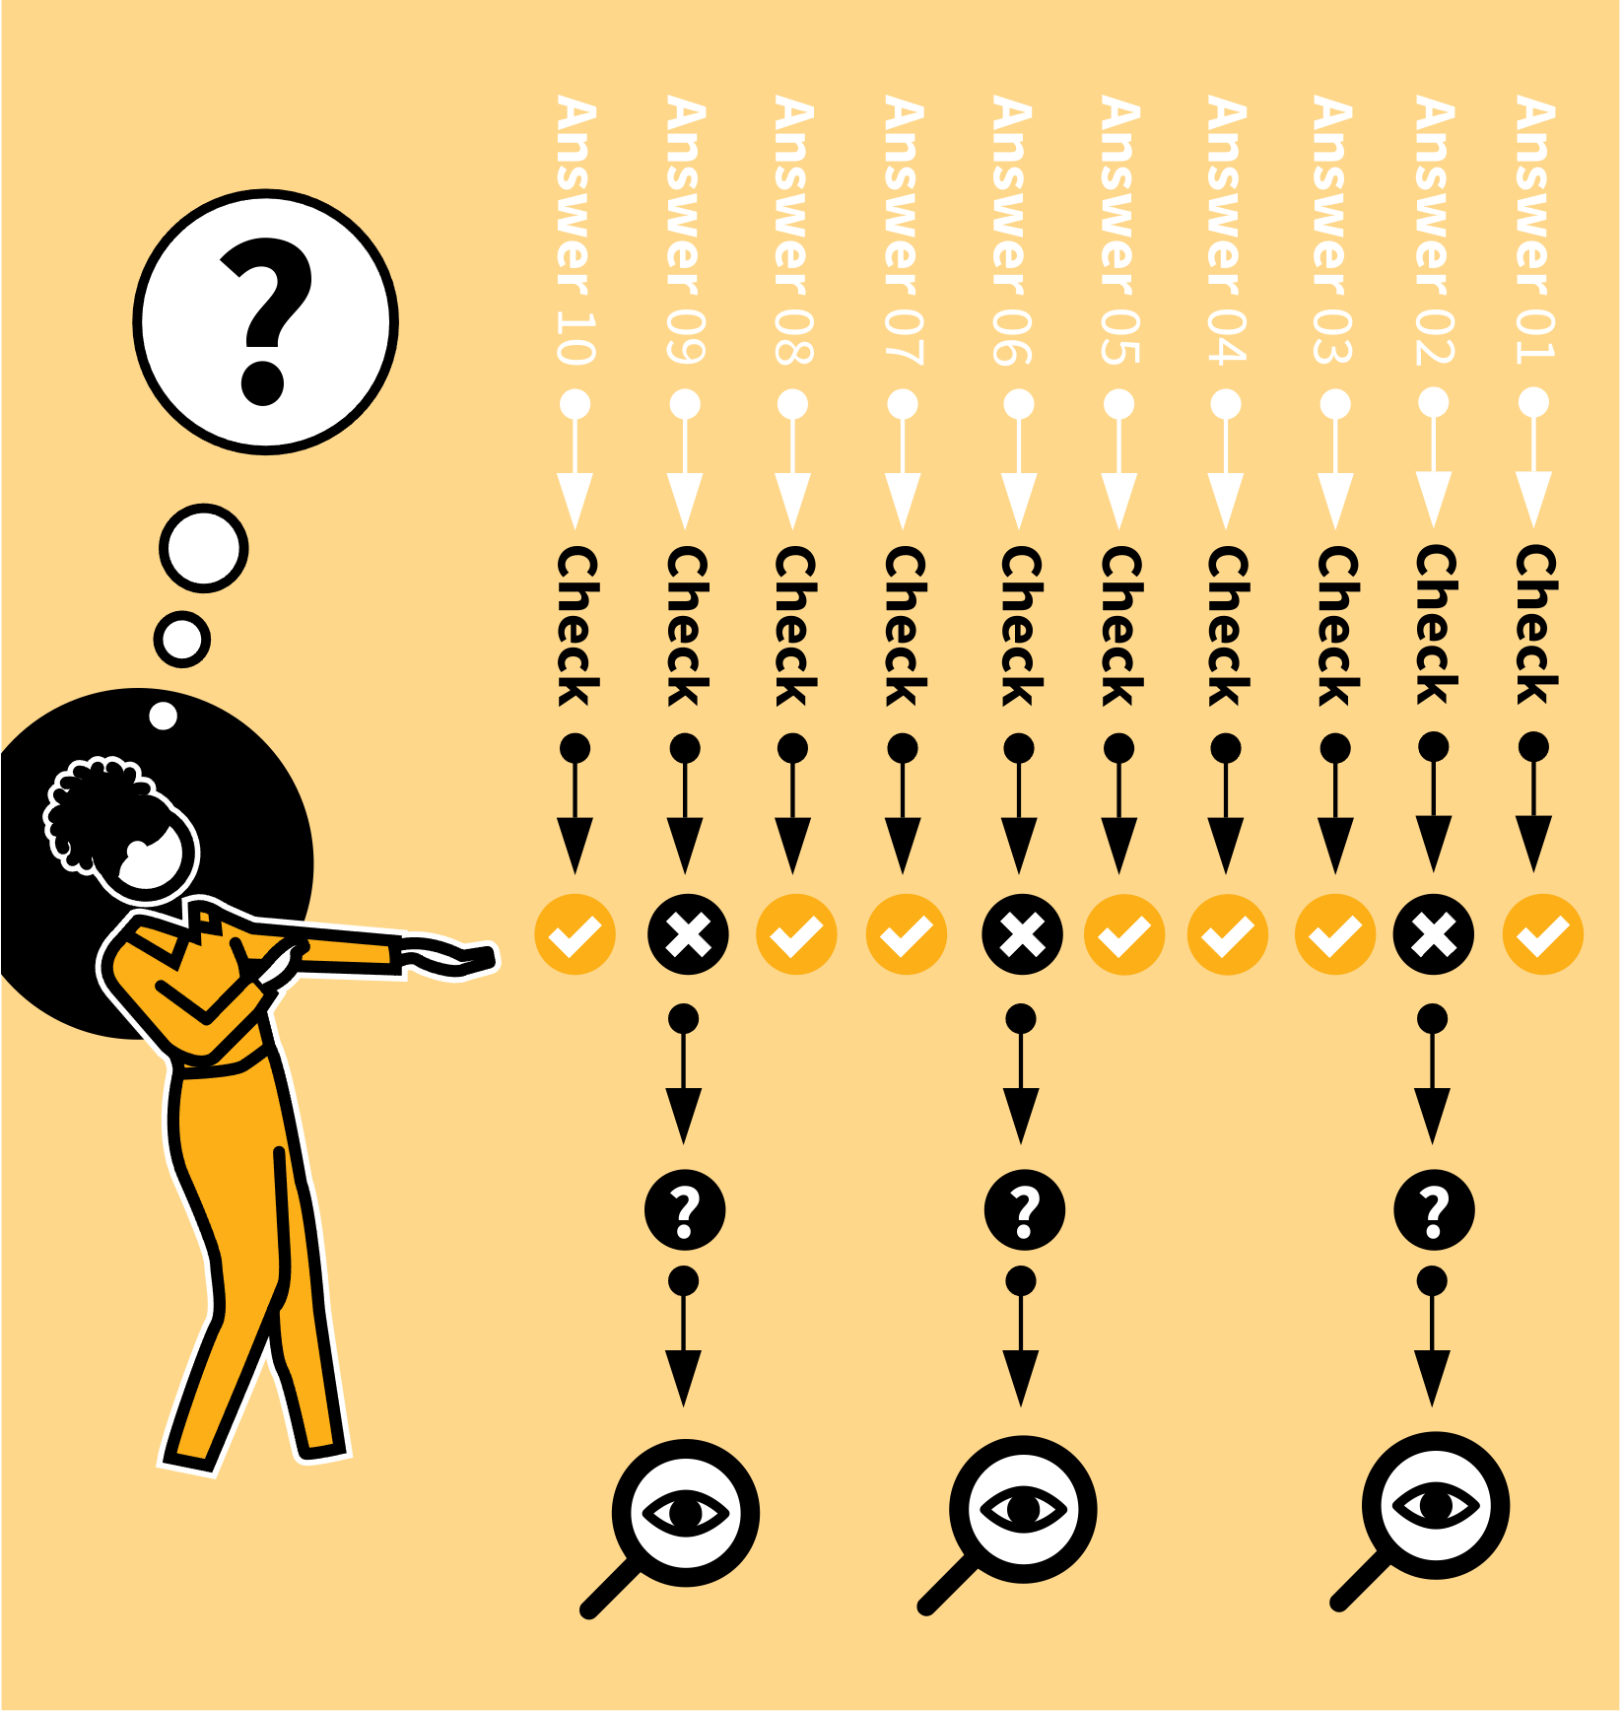
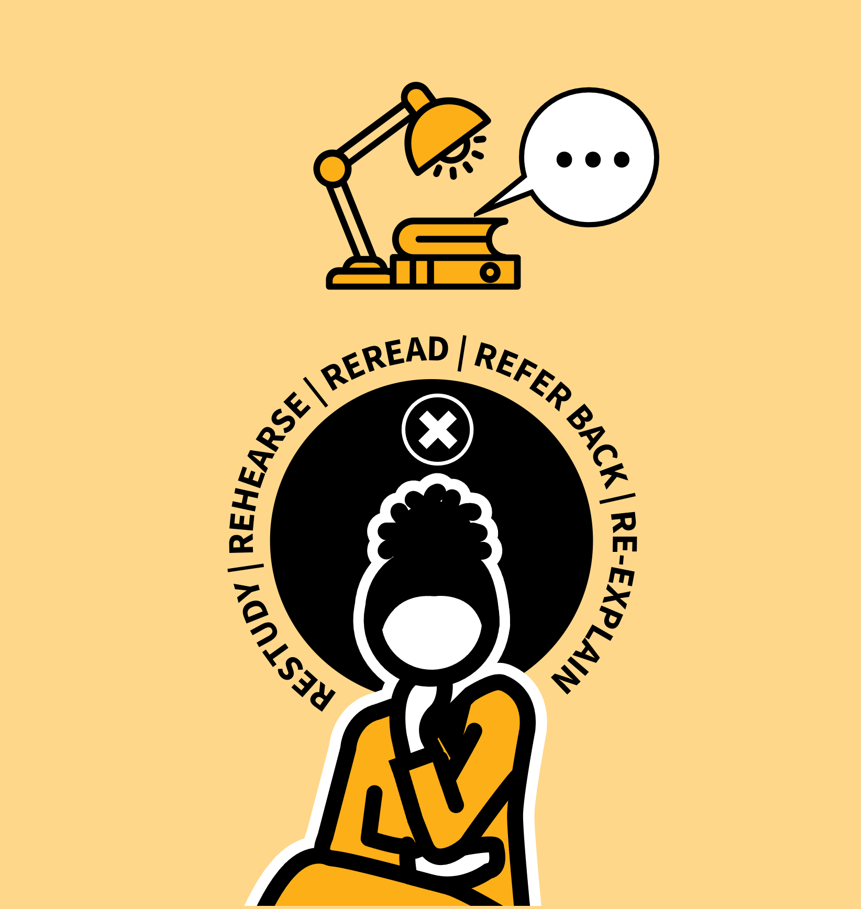
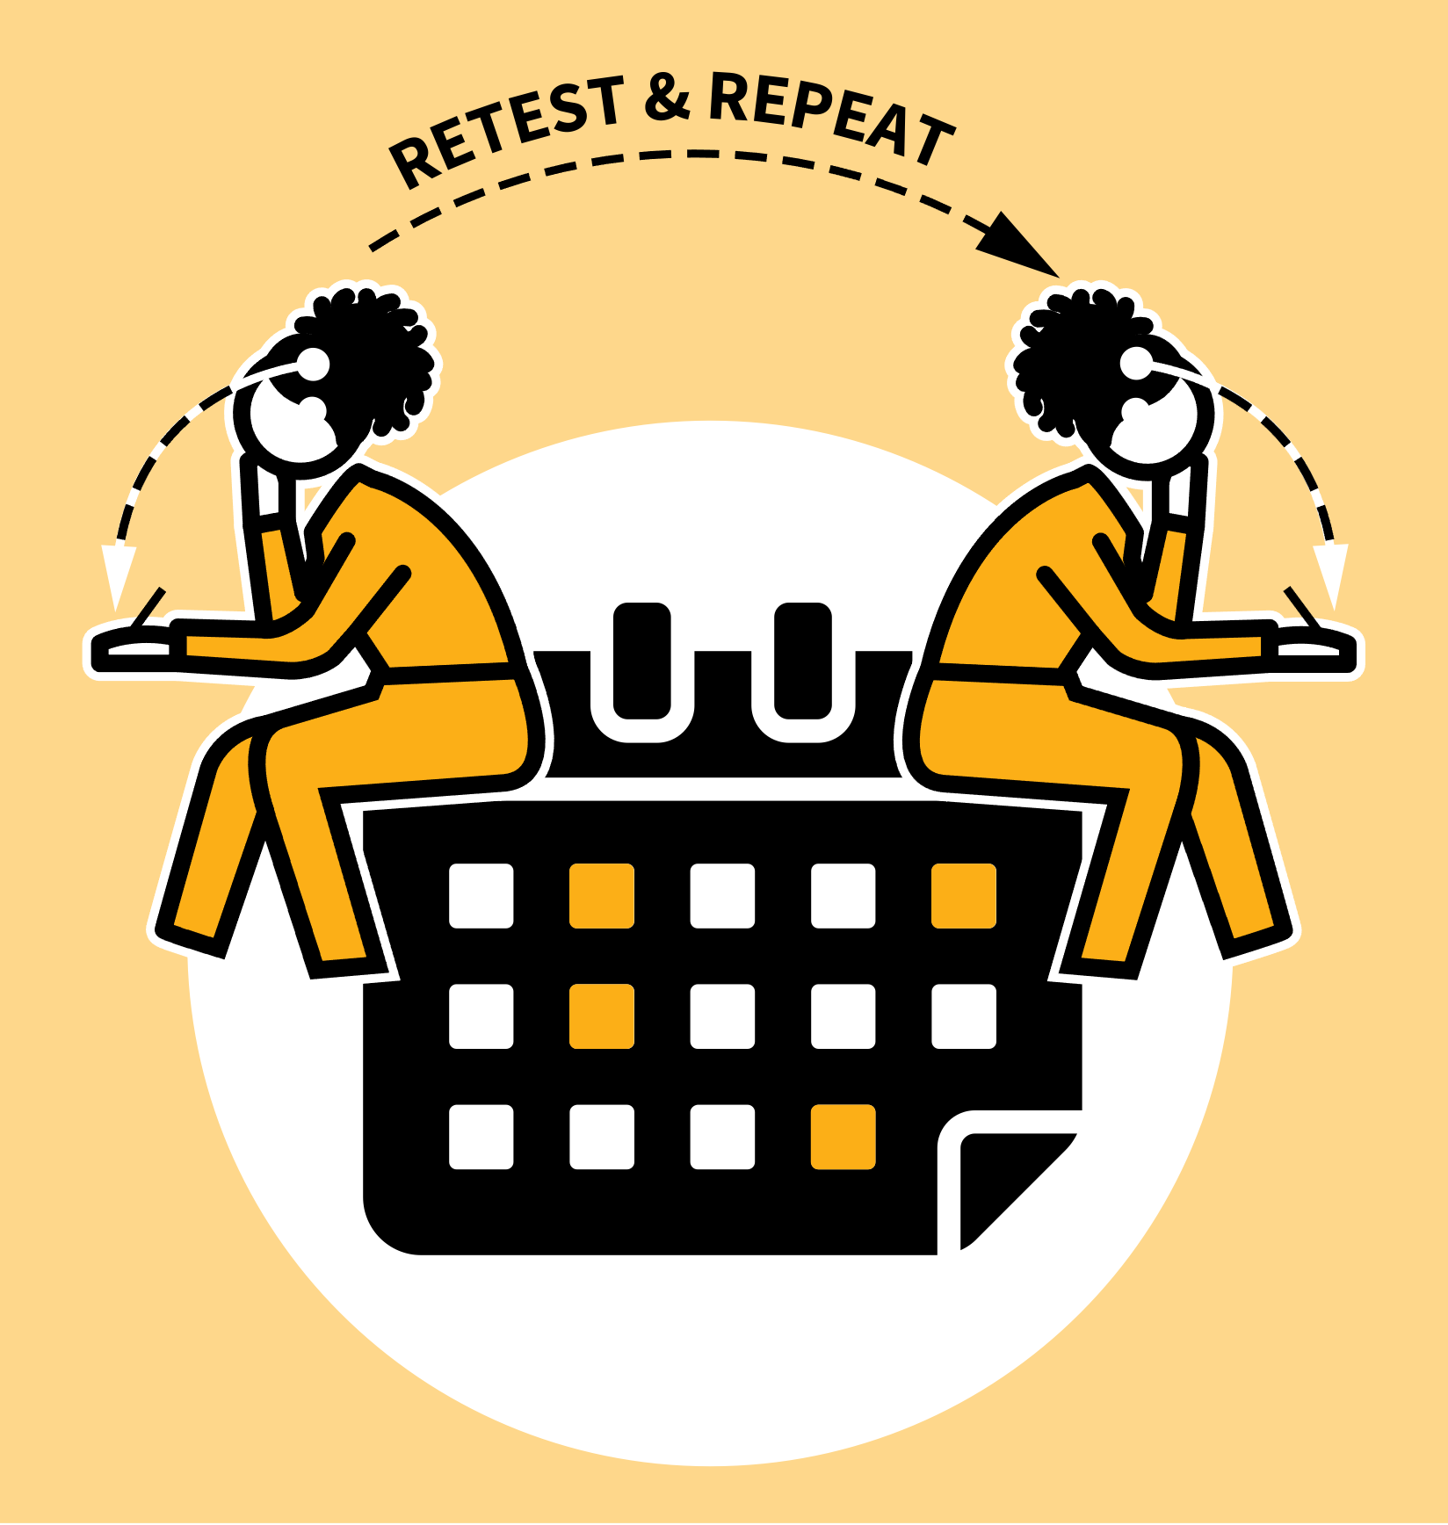
LEARNING WALKTHRUs
STUDY HABITS & TECHNIQUES SERIES
SELF-QUIZZING
1
2
3
4
5
GATHER OR GENERATE QUIZ QUESTIONS
ANSWER THE QUESTIONS UNAIDED
CHECK YOUR ANSWERS
IDENTIFY AREAS YOU NEED TO RESTUDY
TEST YOURSELF AGAIN. REPEAT
One of the pitfalls of studying is the illusion of familiarity: you recognise material as you reread it but this lulls you into thinking you must know it.
However it’s only when you can generate responses yourself with confidence that you can really say you’ve learned something.
Self-quizzing is a technique for forming the habit to test your knowledge. It works best with simple factual recall but can also extend into more complex questions.

Slide 4
LEARNING WALKTHRUs
1 | 2 | 3 | 4 | 5
STUDY HABITS & TECHNIQUES SERIES
GATHER OR GENERATE QUIZ QUESTIONS
SELF-QUIZZING
Your study material will probably include quiz questions with a range of styles:
Say who, when or what; explain why or how.
Simple problems; multiple choice, true/false.
Explain the difference between.
You can generate similar questions for simple recall:
definitions of terms, sequences,
labelling diagrams, explaining concepts,
remembering quotes, retelling events.

Slide 5
LEARNING WALKTHRUs
1 | 2 | 3 | 4 | 5
STUDY HABITS & TECHNIQUES SERIES
SELF-QUIZZING
ANSWER THE QUESTIONS UNAIDED
With your questions ready, run through a set of 5-10 of them, producing the answers.
Write them down to check later or do this mentally.
Don’t look things up or ask for help; take your time, think hard and try your best to produce an answer.
You want the most accurate picture of your own knowledge and, since nobody but you will know, you can be very honest with yourself.

Slide 6
LEARNING WALKTHRUs
1 | 2 | 3 | 4 | 5
STUDY HABITS & TECHNIQUES SERIES
SELF-QUIZZING
CHECK YOUR ANSWERS
After your self-quiz, go back to your notes or set of pre-prepared answers to check how well you did.
If they are simply right or wrong, make a note with a tick or cross and for those you got wrong,note what the correct answers were.
Note what you got right to consolidate your knowledge and give you confidence.
For those you got wrong, you need to establish why.

Slide 7
LEARNING WALKTHRUs
1 | 2 | 3 | 4 | 5
STUDY HABITS & TECHNIQUES SERIES
SELF-QUIZZING
IDENTIFY AREAS YOU NEED TO RESTUDY
For wrong answers:
Did you just forget, i.e. you knew it and understood it before but forgot?
Restudy the material, rehearse the answers and try to connect them to more secure knowledge.
Do you not fully understand the question or the material in general? This is more significant.
Reread more of your notes, refer back to worked examples or ask a teacher to re-explain it to you.

Slide 8
LEARNING WALKTHRUs
1 | 2 | 3 | 4 | 5
STUDY HABITS & TECHNIQUES SERIES
SELF-QUIZZING
TEST YOURSELF AGAIN.
REPEAT
If you test yourself again straight away you’ll remember the answers because you only just went through them. This doesn’t tell you how secure your knowledge is, but it’s a reassuring check and acts as a kind of rehearsal.
To be more accurate, test yourself repeatedly on similar material or using the same questions, at a later point — a day or a week later perhaps.
You should find you remember more each time.

Slide 9
LEARNING WALKTHRUs
STUDY HABITS & TECHNIQUES SERIES
SELF-QUIZZING
1
2
3
4
5
GATHER OR GENERATE QUIZ QUESTIONS
ANSWER THE QUESTIONS UNAIDED
CHECK YOUR ANSWERS
IDENTIFY AREAS YOU NEED TO RESTUDY
TEST YOURSELF AGAIN. REPEAT
One of the pitfalls of studying is the illusion of familiarity: you recognise material as you reread it but this lulls you into thinking you must know it.
However it’s only when you can generate responses yourself with confidence that you can really say you’ve learned something.
Self-quizzing is a technique for forming the habit to test your knowledge. It works best with simple factual recall but can also extend into more complex questions.

