Slide 1
The Bathurst Way
How to revise
Practice explaining

Slide 2
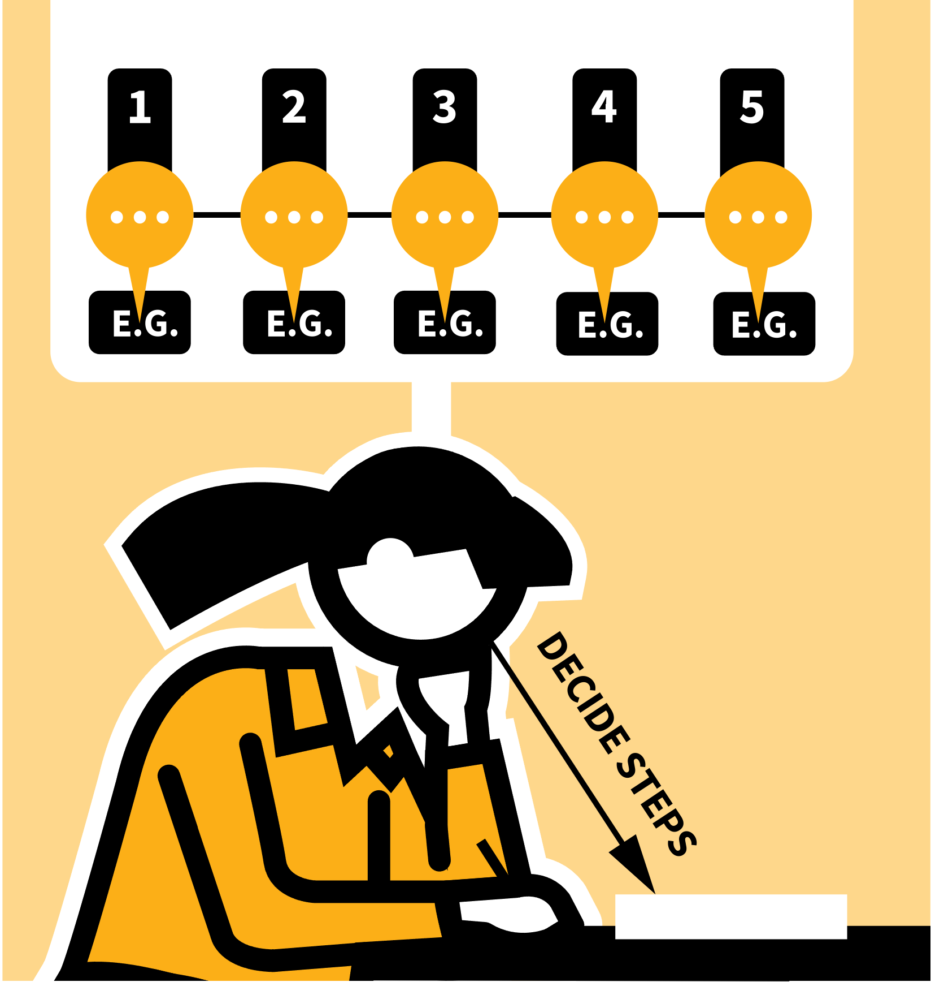
LEARNING WALKTHRUs
STUDY HABITS & TECHNIQUES SERIES
PRACTISE EXPLAINING
1
2
3
4
5
STUDY & MAKE SENSE OF THE MATERIAL
RUN THROUGH THE EXPLANATION WITH PROMPTS
RUN THROUGH THE EXPLANATION WITHOUT PROMPTS
REVIEW YOUR SUCCESS; CHECK FOR ACCURACY
REPEAT THE EXPLANATION, ADDING DETAILS
Self-explanation has been found to be effective by cognitive scientists. It can be done in your head or an actual explanation you give out loud, to an audience. You can do it in pairs in class or by yourself studying at home.
To explain something you have to pull together the relevant knowledge, put it in the right sequence and connect it up so that the idea you’re explaining makes sense.
This strengthens connections you’ve made and flushes out areas you’re still not sure of.

Slide 3
LEARNING WALKTHRUs
1 | 2 | 3 | 4 | 5
STUDY HABITS & TECHNIQUES SERIES
STUDY & MAKE SENSE
OF THE MATERIAL
PRACTISE EXPLAINING
Before you can explain something, you need to make sense of it yourself:
VISUALISE or create a mental model for how something works.
ORGANISE your thoughts into a sequence like you do in telling a story.
LINK IDEAS TO VISUALS | Diagram, image or flow chart (this is dual coding).
ESTABLISH SPECIFIC EXAMPLES of the concepts you’re making sense of.

Slide 4
LEARNING WALKTHRUs
1 | 2 | 3 | 4 | 5
STUDY HABITS & TECHNIQUES SERIES
RUN THROUGH THE EXPLANATION WITH
PROMPTS
PRACTISE EXPLAINING
To begin with, get your ideas straight. It’s not a memory test — yet!
Decide which examples you’ll use and where the visuals are necessary or helpful.
Run through the explanation, breaking it down into some key steps.
Decide where to start and what order your explanatory steps should go in. Five or six steps is a useful number to aim for - not too many!

Slide 5
LEARNING WALKTHRUs
1 | 2 | 3 | 4 | 5
STUDY HABITS & TECHNIQUES SERIES
RUN THROUGH THE
EXPLANATION WITHOUT
PROMPTS
PRACTISE EXPLAINING
When you’re happy with your explanation with notes, try without them just using any diagrams.
Run through the steps, trying to remember each one and the order they go in. Don’t aim for word-for-word repeat; you’re not reciting a rehearsed script.
Try to communicate the ideas clearly in the order you first rehearsed, with as much detail as you can and without leaving out any vital information.

Slide 6
LEARNING WALKTHRUs
1 | 2 | 3 | 4 | 5
STUDY HABITS & TECHNIQUES SERIES
PRACTISE EXPLAINING
REVIEW YOUR SUCCESS; CHECK FOR ACCURACY
Having tried to explain the idea from memory, go back to your notes to see how well you did.
If you’re working with a partner, they can do this for you, giving you some feedback.
Did you include all the examples?
Did you get the steps in a sensible order so it made sense, linking one step to the next?
Did you use the appropriate vocabulary and formal terminology?
What did you leave out?

Slide 7
LEARNING WALKTHRUs
1 | 2 | 3 | 4 | 5
STUDY HABITS & TECHNIQUES SERIES
REPEAT THE
EXPLANATION, ADDING
DETAILS
PRACTISE EXPLAINING
Getting it right the first time is unlikely. It pays to practise explaining, improving each time, adding more details or becoming more fluent in linking the ideas mentally or in how you express them out loud.
Use the technique multiple times when you’re rehearsing mentally.
If you’re explaining out loud to a partner, try it at least twice so you can see an improvement from your first to your second attempt.

