Slide 1

Start your Bronze DofE

Slide 2
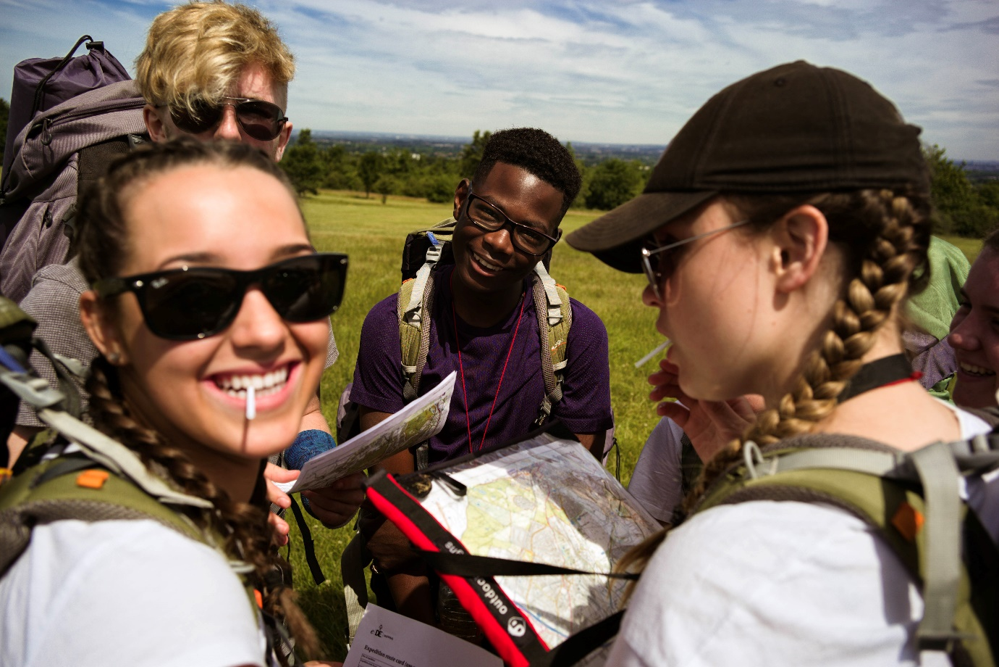
What is the DofE?
BRONZE
The DofE’s a life-changing adventure you don’t want to miss.
It’s about going the extra mile ­– learning new skills for work and life, getting fitter, making a difference and broadening your horizons.
Millions of young people in the UK have already done their DofE.
Now it’s your turn.

Slide 3
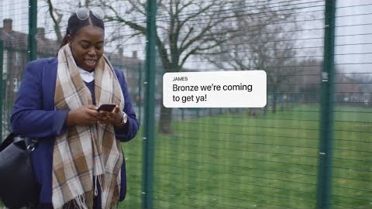
What is the DofE?
BRONZE

Slide 4
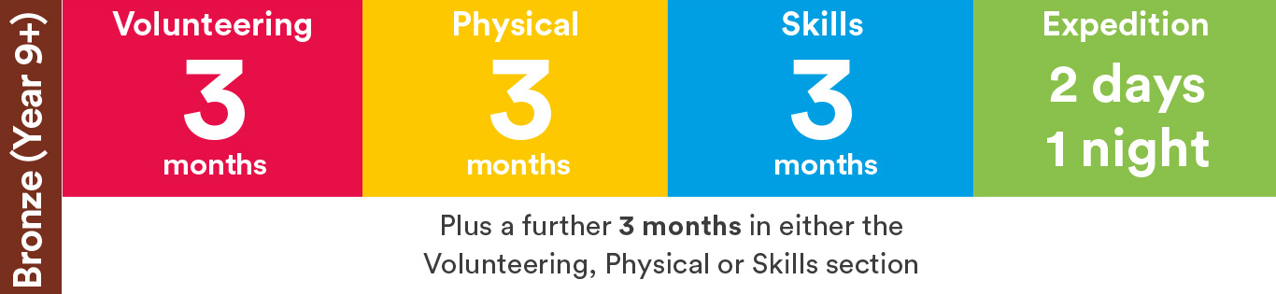
How do I choose my activities?
BRONZE
There’s loads to choose from ­­— most activities can count towards your DofE.
Maybe you want to try something new? Or get better at something you already do? Your DofE can be whatever you want it to be.
Activities for each DofE section take a minimum of one hour a week over a set period of time, so they can fit in around your studies and life outside school.

Slide 5
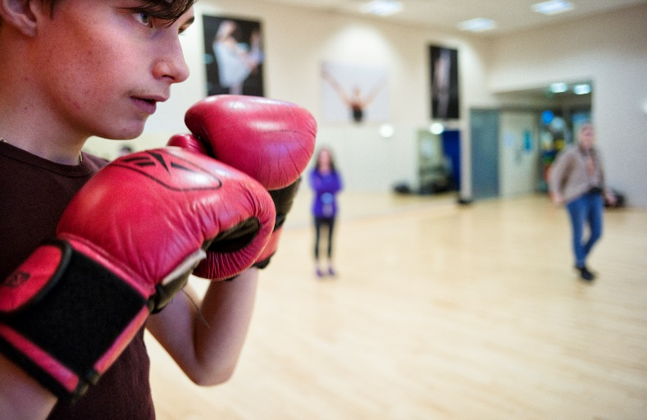
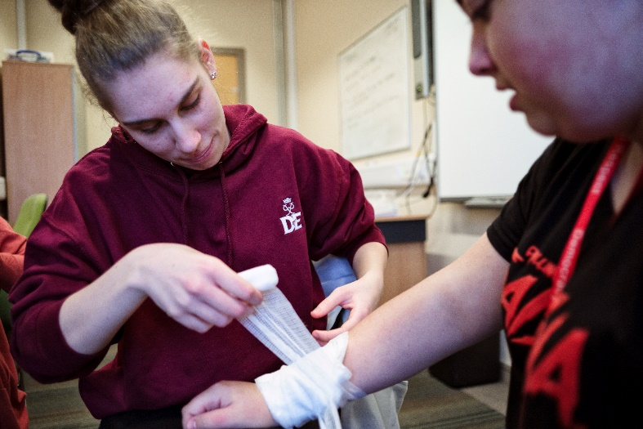
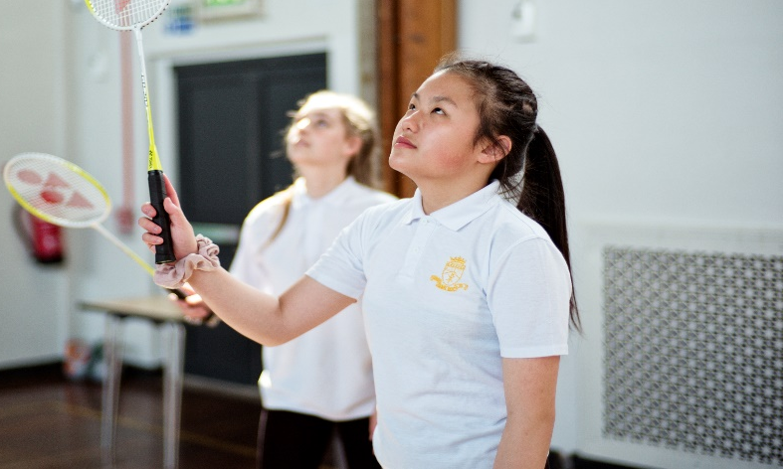
What will you do?
BRONZE
Volunteering
Physical
Volunteering’s all about taking action and making a difference.
You can choose the cause that means most to you.
From coaching a local football team to starting a campaign, you’ll give up your time to change things for the better.
It’s extremely rewarding — and it can give you the chance to experience the world of work.
The Physical section is a chance for you to focus on your health and fitness — and have fun along the way.
Try something different or concentrate on something you already do. From yoga to gym, skateboarding to wheelchair tennis — almost any dance, sport or fitness activity can count.
You can join a team or do it on your own. It’s up to you.

Slide 6
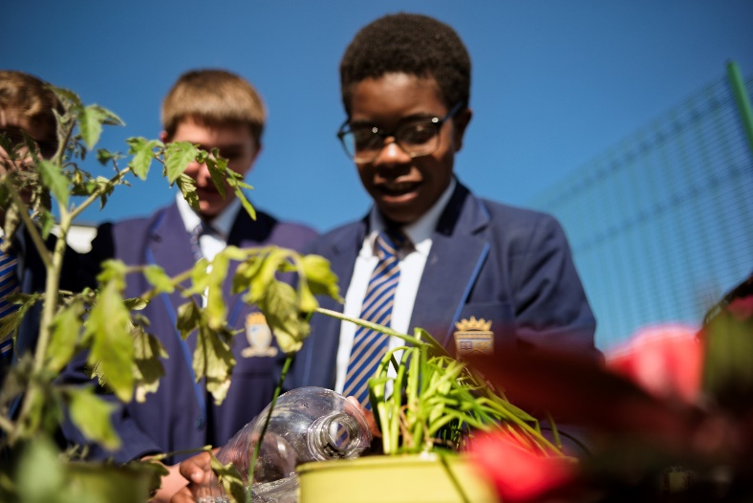
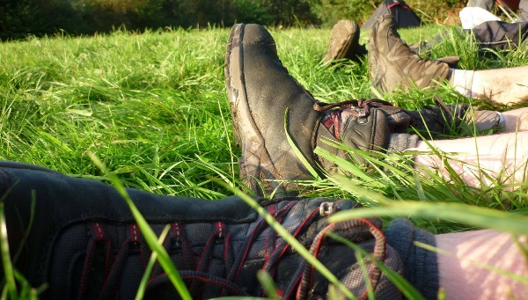
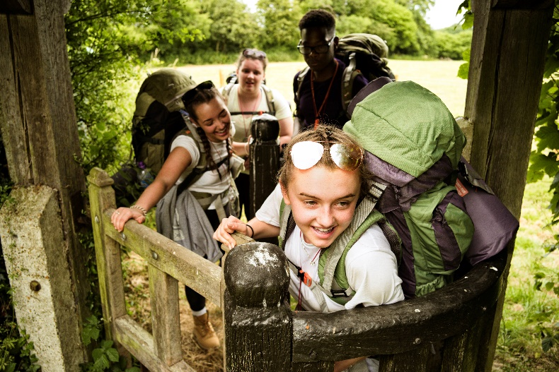
What will you do?
BRONZE
Skills
Expedition
From coding to cookery, the Skills section lets you learn a new talent, develop existing skills and find something you love doing.
If you’re interested in a specific field, this could be the perfect chance to do something related to it. If you’re interested in photography, for example, you could do that as your skill.
You’ll grow in confidence and get a real sense of achievement.
Your expedition will give you lifelong memories.
With a team of friends, you’ll plan your aim, choose your location and do some training to make sure you’re prepared — then spend two days and one night away.
You can choose how you travel. You could do it on foot, by bike, canoe, kayak, wheelchair, sailing boat or even on horseback.

Slide 7
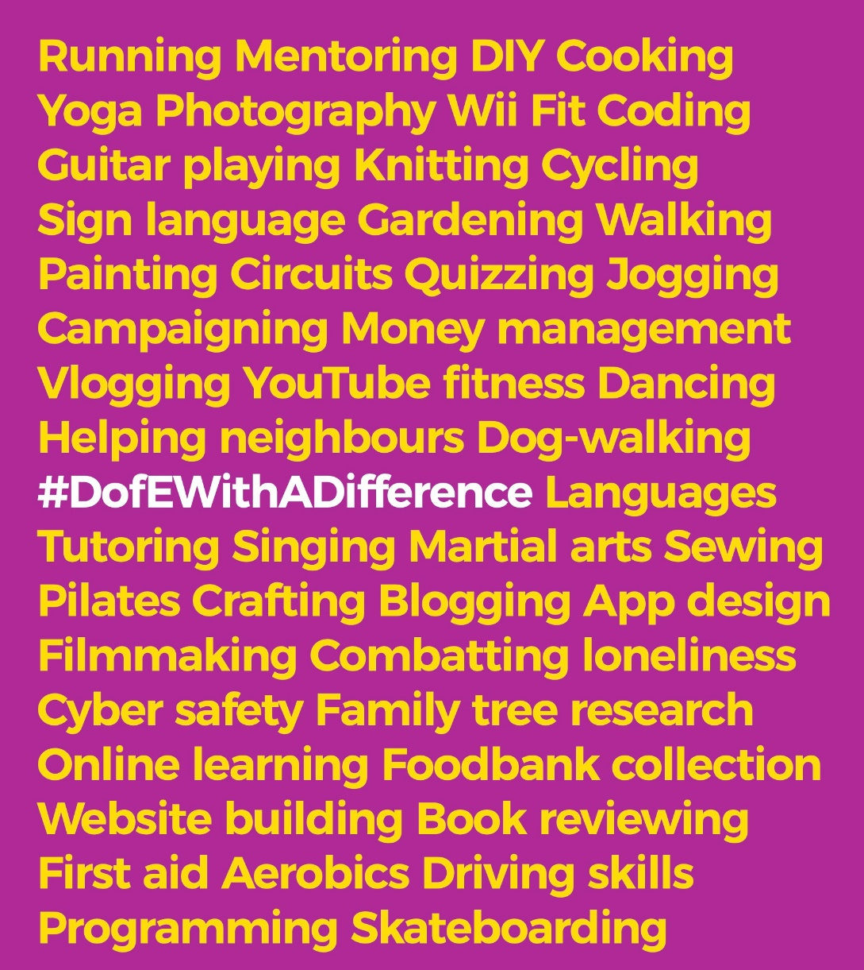
Your DofE and COVID-19
BRONZE
The COVID-19 outbreak won’t stop you doing your DofE – far from it.
In fact, the DofE can help you navigate your ‘new normal’, expand your world and give you skills and experiences that can open doors in the future.
You get to choose and change your own activities, so you can pick ones that are easy to do safely under social distancing guidelines or from home.
There are flexible ways to run expeditions so – when it’s safe to do so and Government guidelines allow – you can do yours, with all the benefits and memories you’d get at any other time.
Visit DofE.org/DofEWithADifference for loads of activity ideas and information.

Slide 8
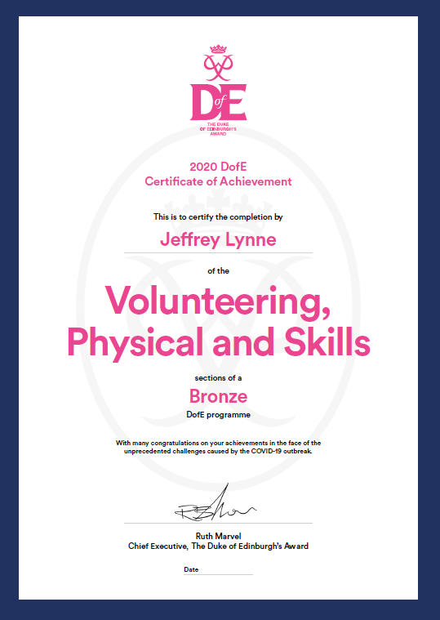
The DofE Certificate of Achievement
BRONZE
During and in the aftermath of the COVID-19 outbreak, participants who complete their Skills, Volunteering and Physical sections will receive a special DofE Certificate of Achievement.
This is a formal recognition, by the DofE, of the effort, skill and commitment you've shown at this extraordinary time.
The Certificate can act as a talking point on your CV or in your personal statement and help you stand out.
And you can still do your expedition and achieve your Bronze DofE Award.

Slide 9

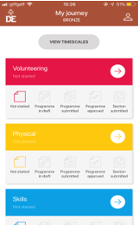
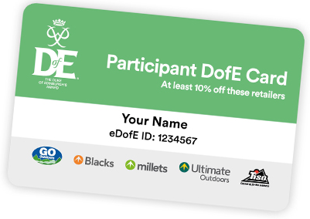
Your Welcome Pack and eDofE
BRONZE
Once you've signed up to do your DofE, you'll get your own eDofE account, so you can start planning your activities online and using the free DofE app.
When you've added your home address, you'll be sent your Welcome Pack – with lots of information and advice, as well as your personalised DofE Card.
Your DofE Card will give you and your family exclusive discounts in the DofE's five fantastic recommended retailers.

Slide 10
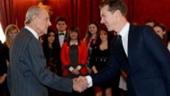

Why do your DofE?
So why should you do your DofE?
It’s hard to list all the benefits of achieving your Bronze Award, so here’s a quick snapshot. You’ll…
Have lots of fun
Get healthier and happier
Meet incredible people and make lasting friendships
Have amazing new experiences
Find talents and passions you didn’t know you had
Gain skills that employers value, which you can use on your CV
Become more confident and independent
Stand out from the crowd in college, university and job applications
Make memories that will last a lifetime.
“As an actor I know how much Award holders’ experiences and the skills they’ve developed matter. Without determination and passion I wouldn’t be where I am today.” Benedict Cumberbatch, actor.
“Life doesn’t naturally happen, you’ve got to get involved. What better way to do that than do your DofE. As an employer I want to work with people who have a range of skills and can see things through.” Deborah Meaden, entrepreneur.

Slide 11

Start your DofE now
BRONZE
Are you ready to start an adventure you’ll never forget?
To get started with your DofE, speak to Mr Steele, Mr Begley or your Form Tutor.
  Mr Steele
    DofE Manager
The DofE is a charity.
Visit DofE.org for more information.

